Slide 1
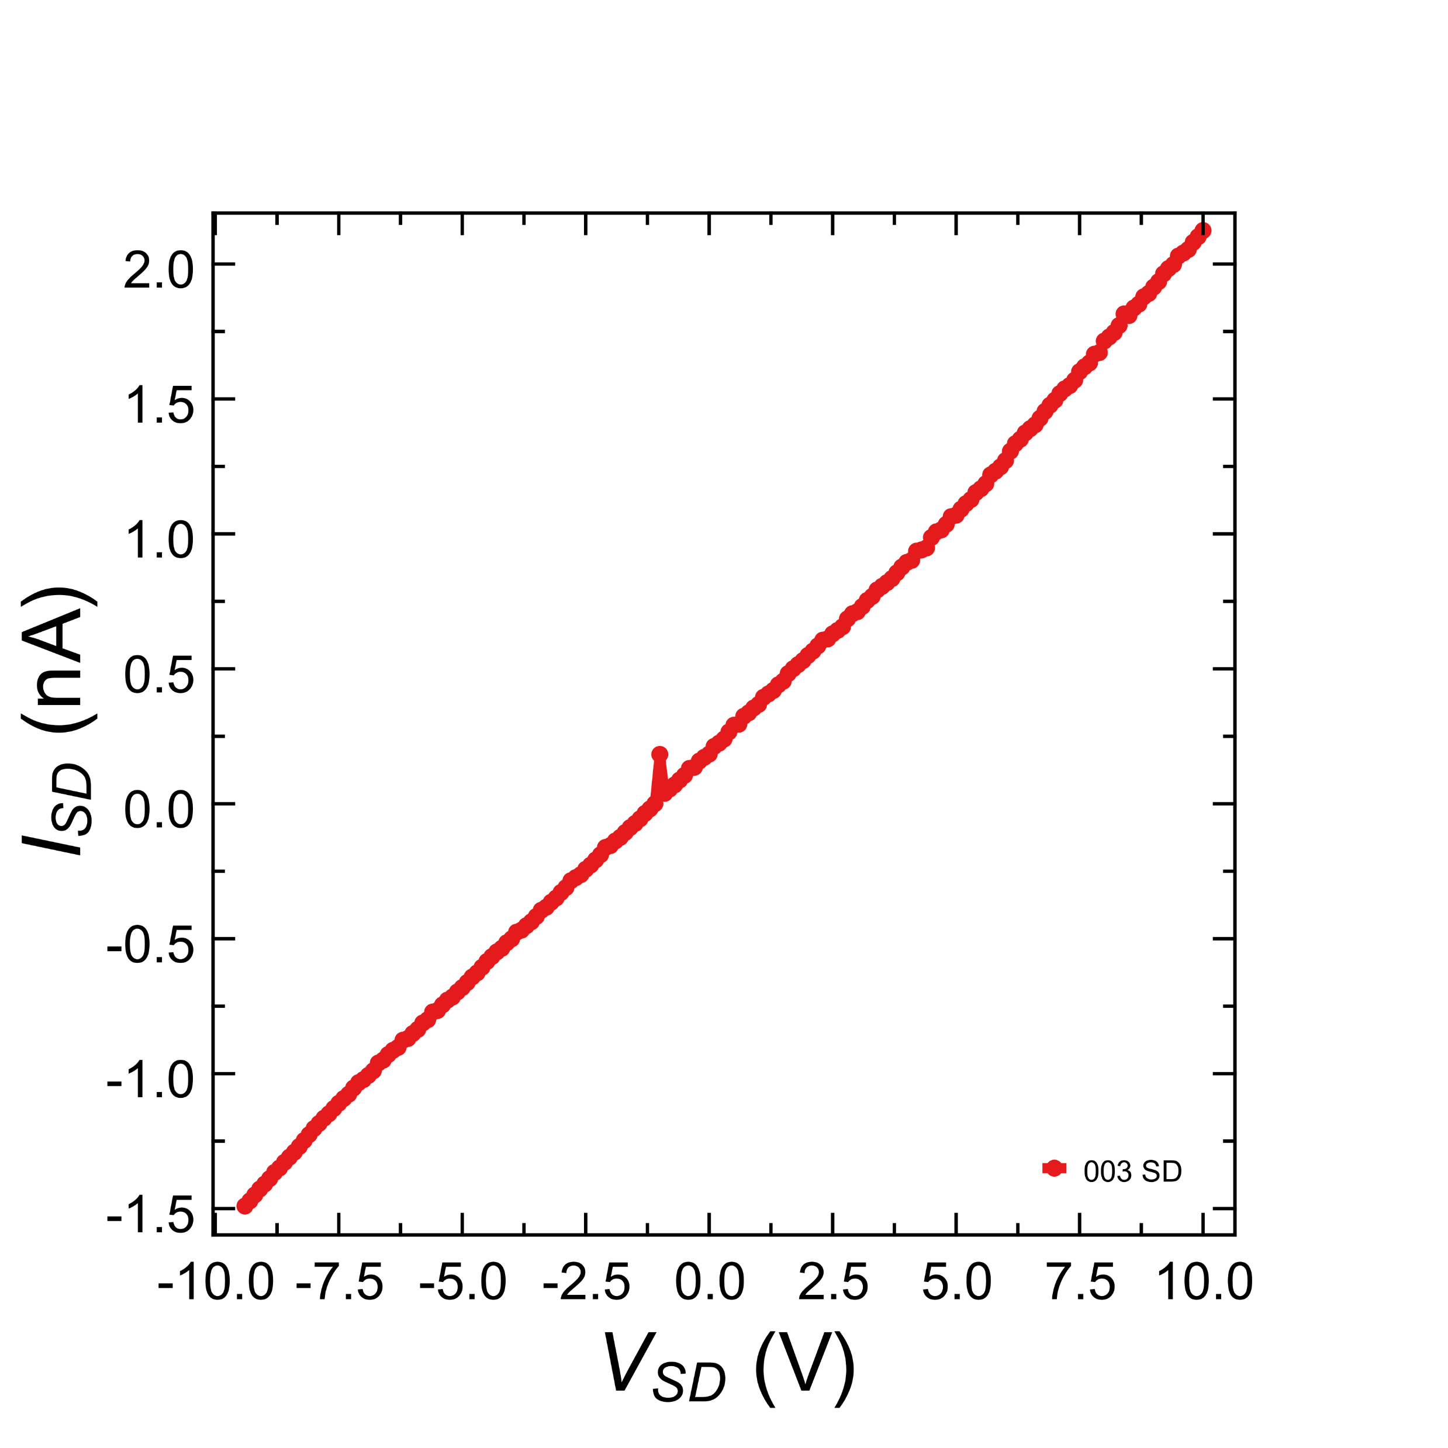
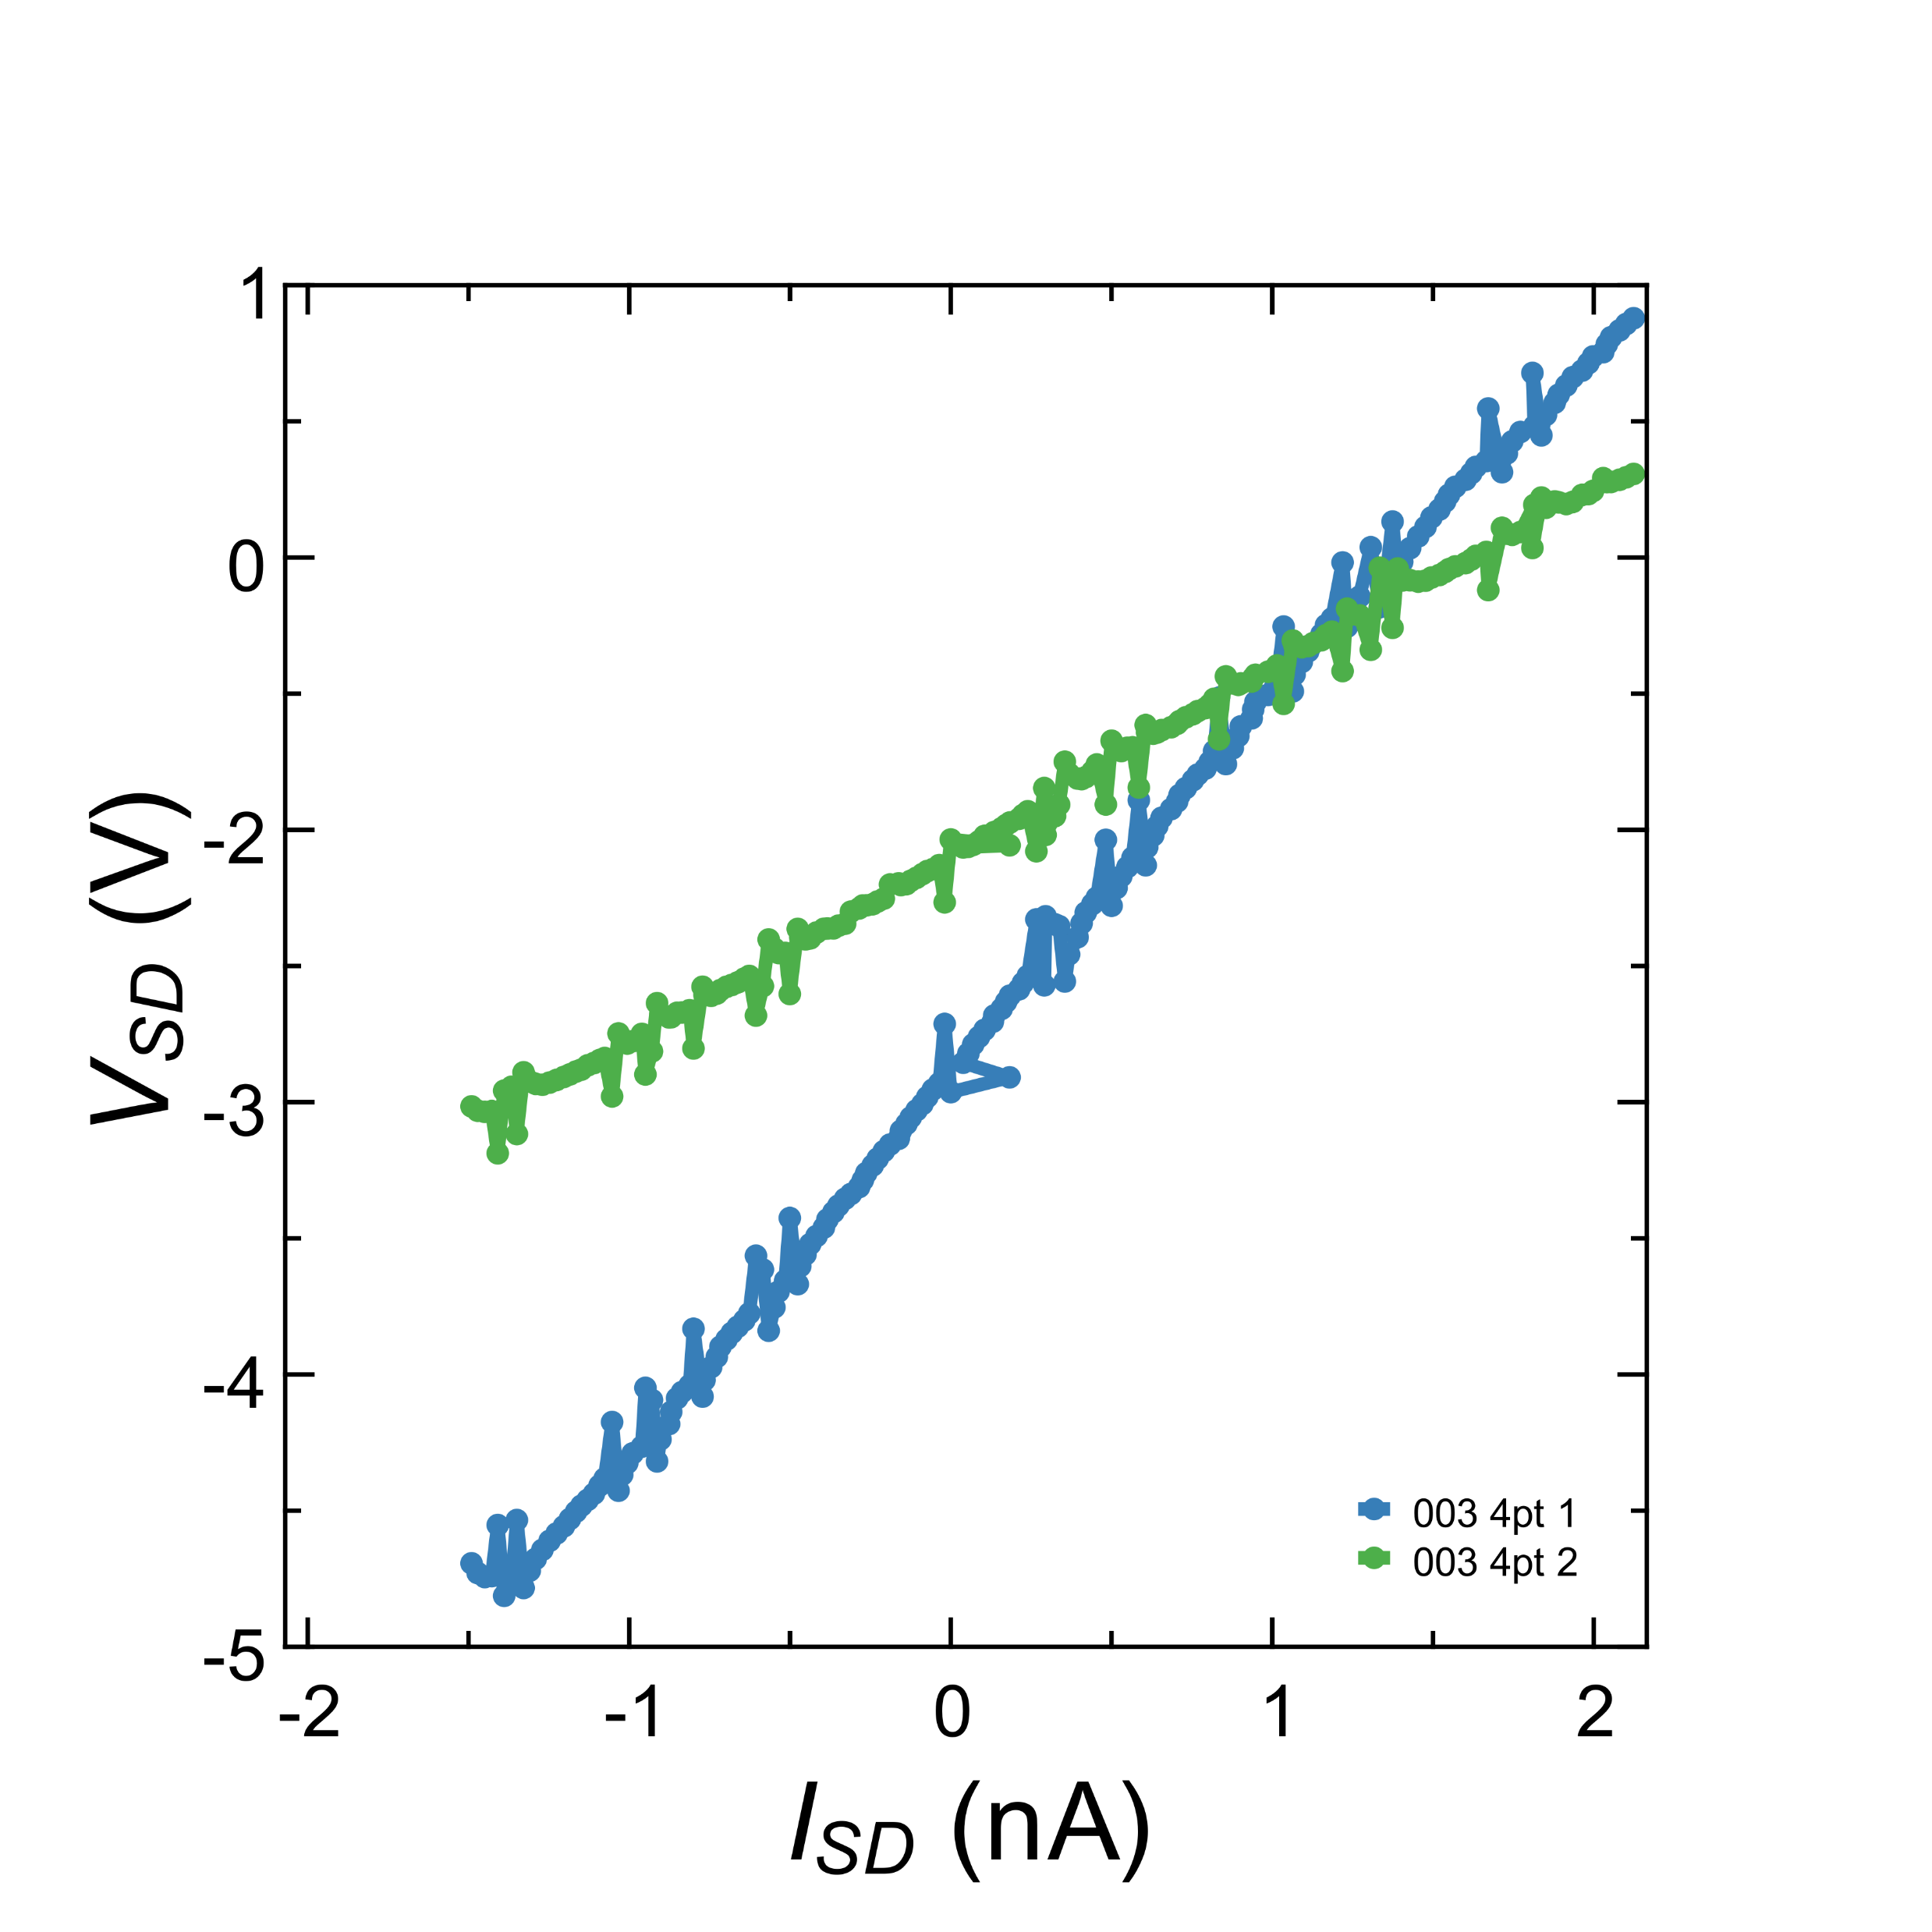


Sample “Large Trapezoid” 7
$$R_{4pt1}=1.762GΩ$$
$$R_{4pt2}=0.885GΩ$$
$$R_{SD}=5.518 GΩ$$
2pt and 4pt measurements taken together with voltage bias at 300K. Initial few data points removed as they showed capacitance current. Samples very sensitive to range and settings of 6430 and 2182A, that may account for difference in 4pt measurements.

Slide 2
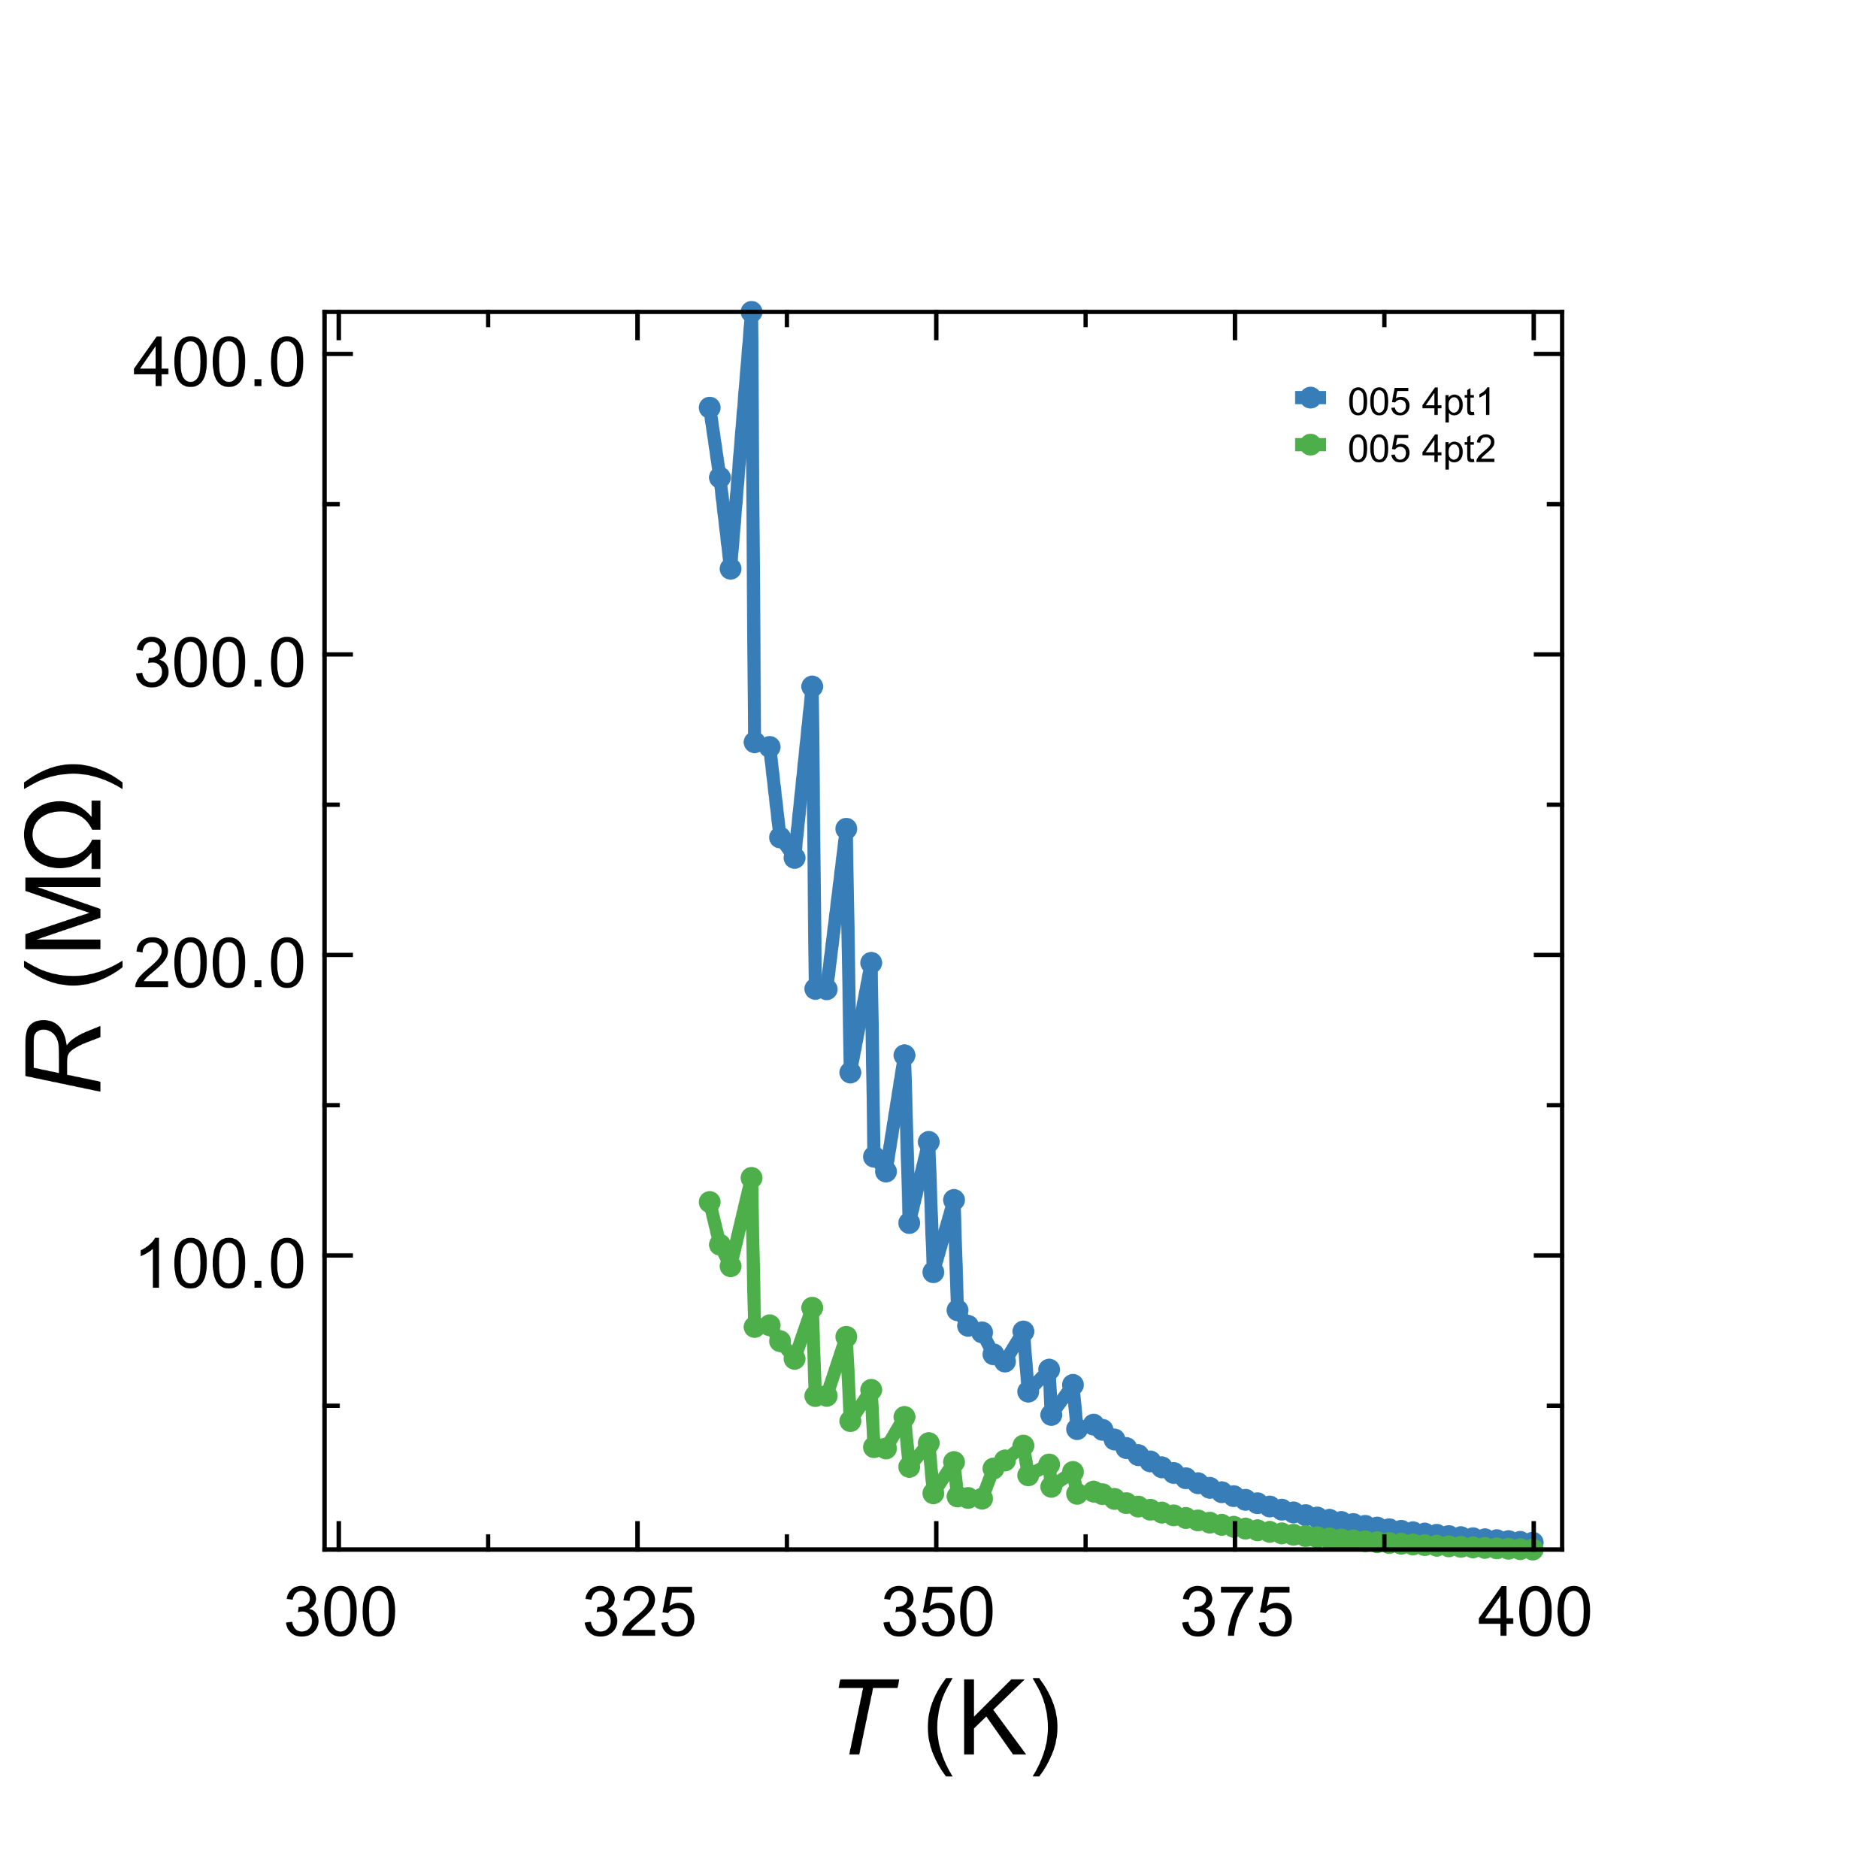
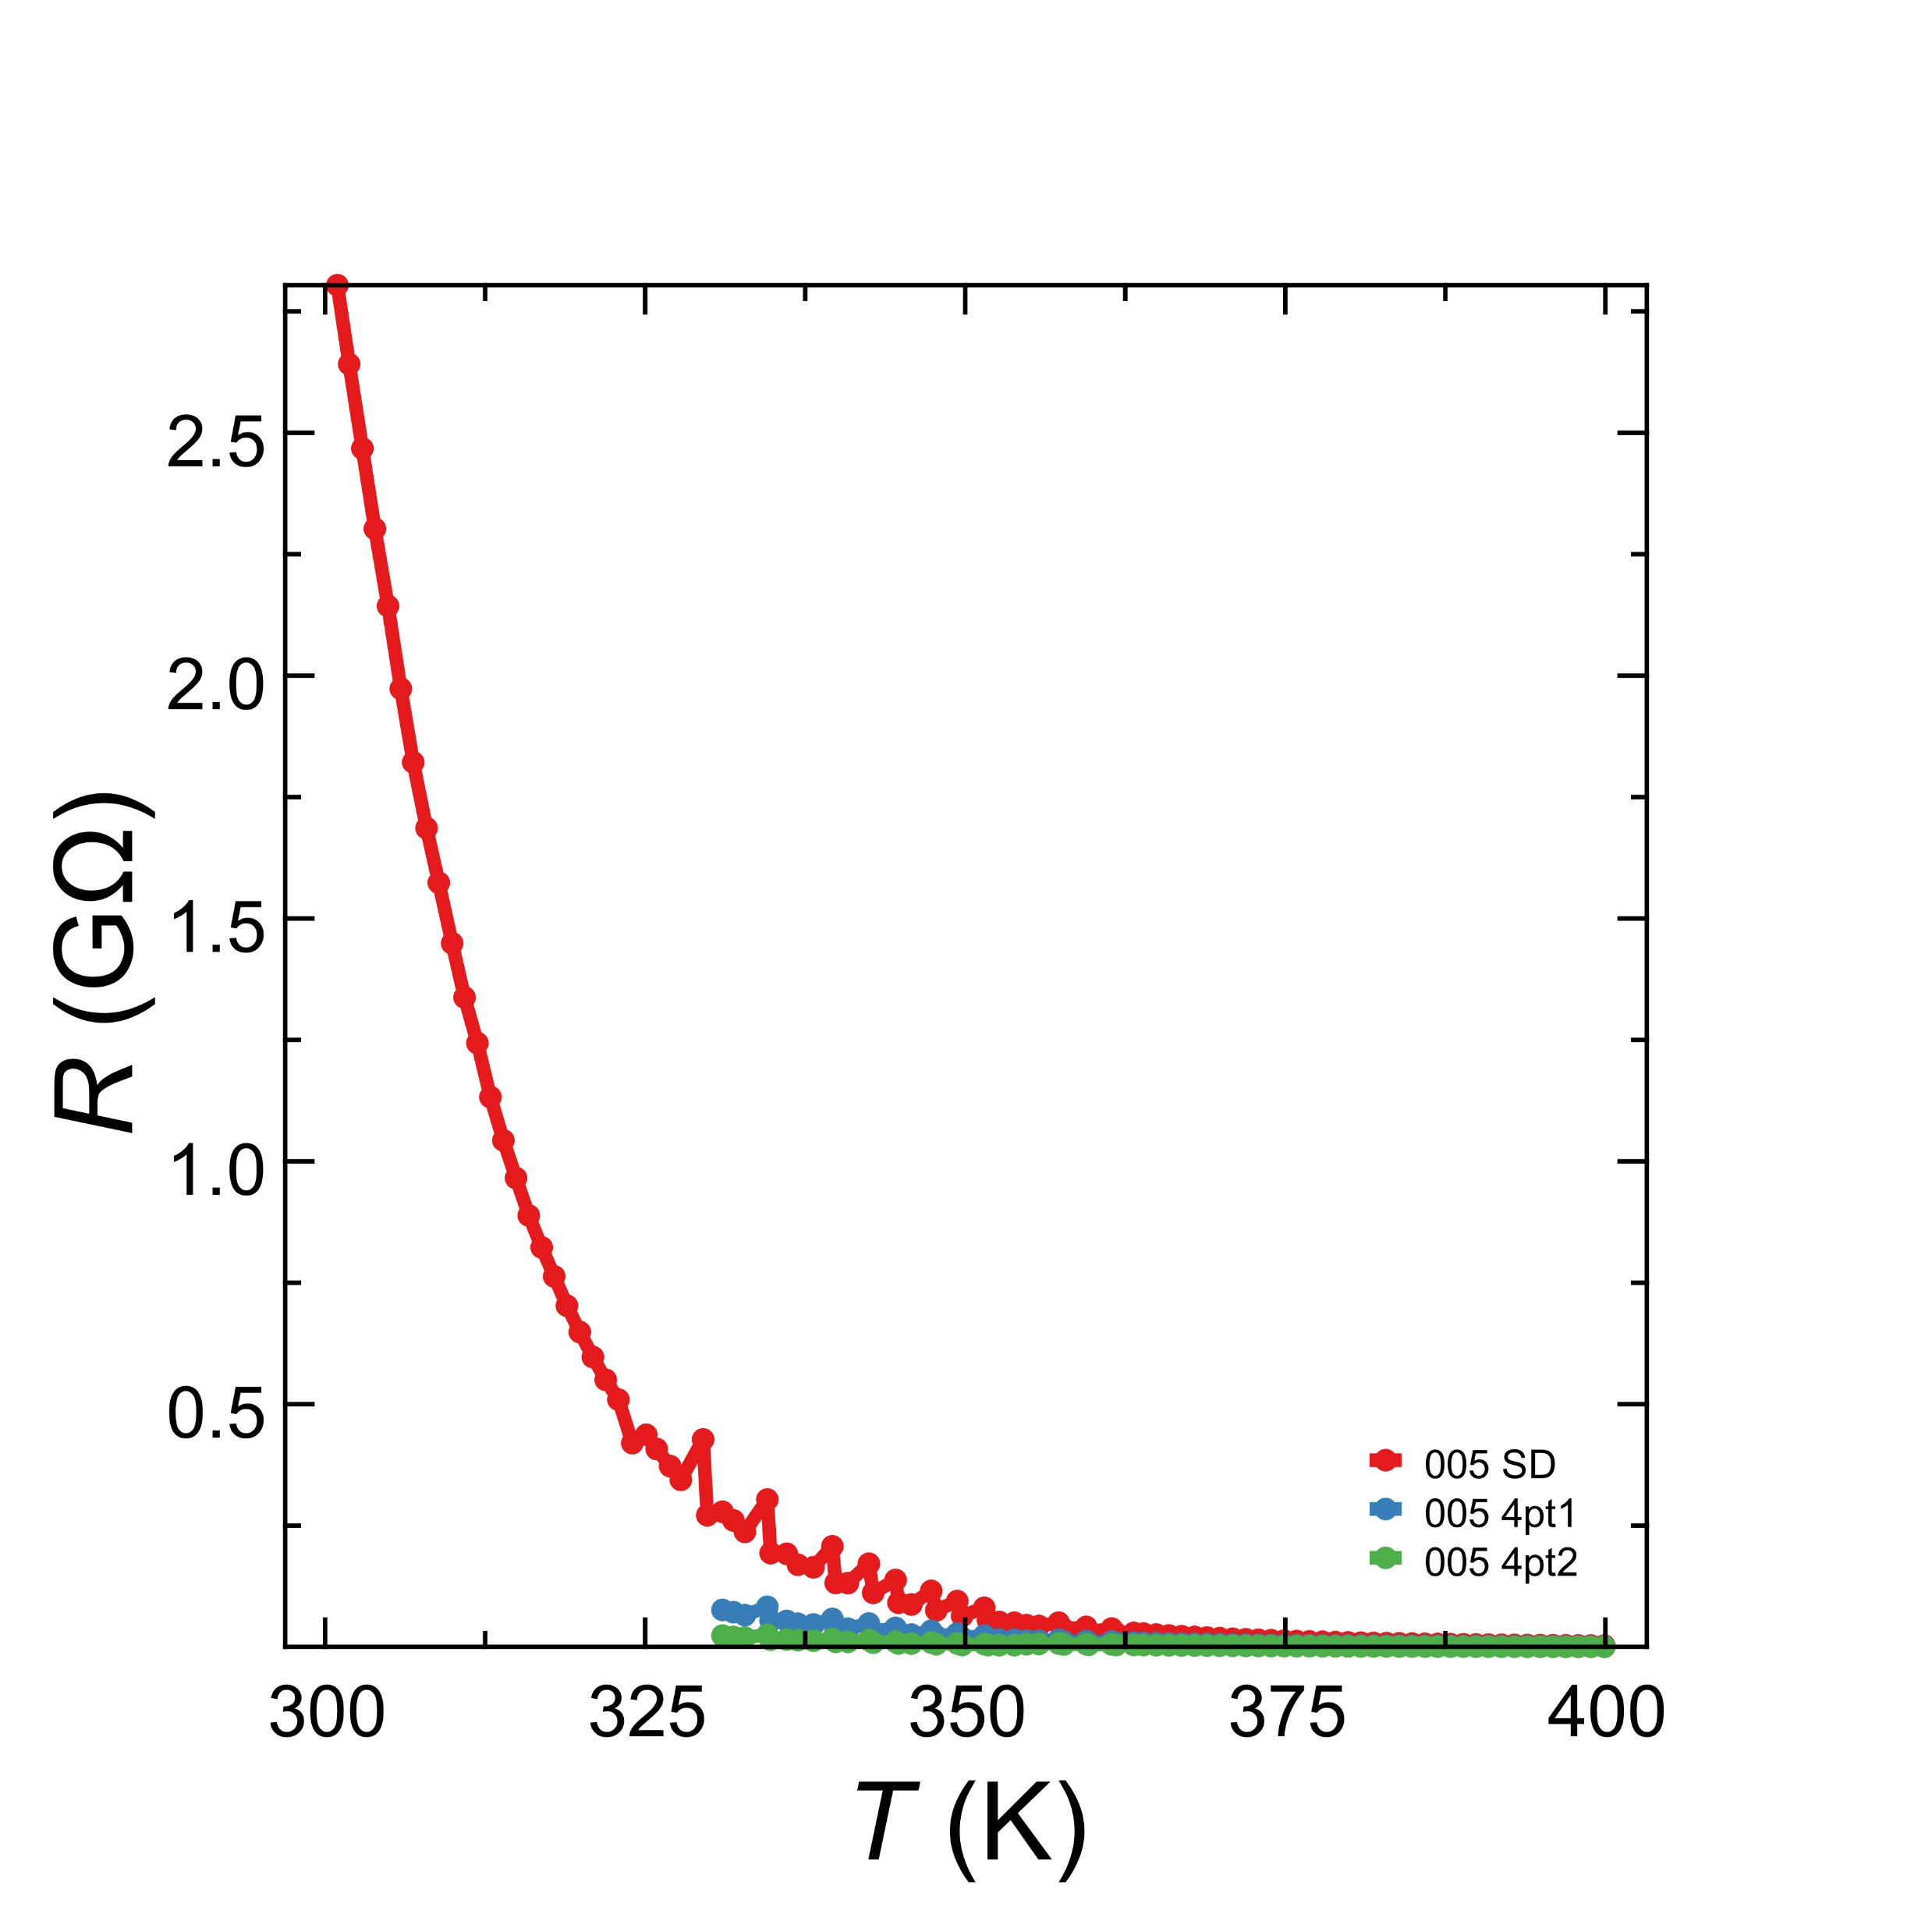
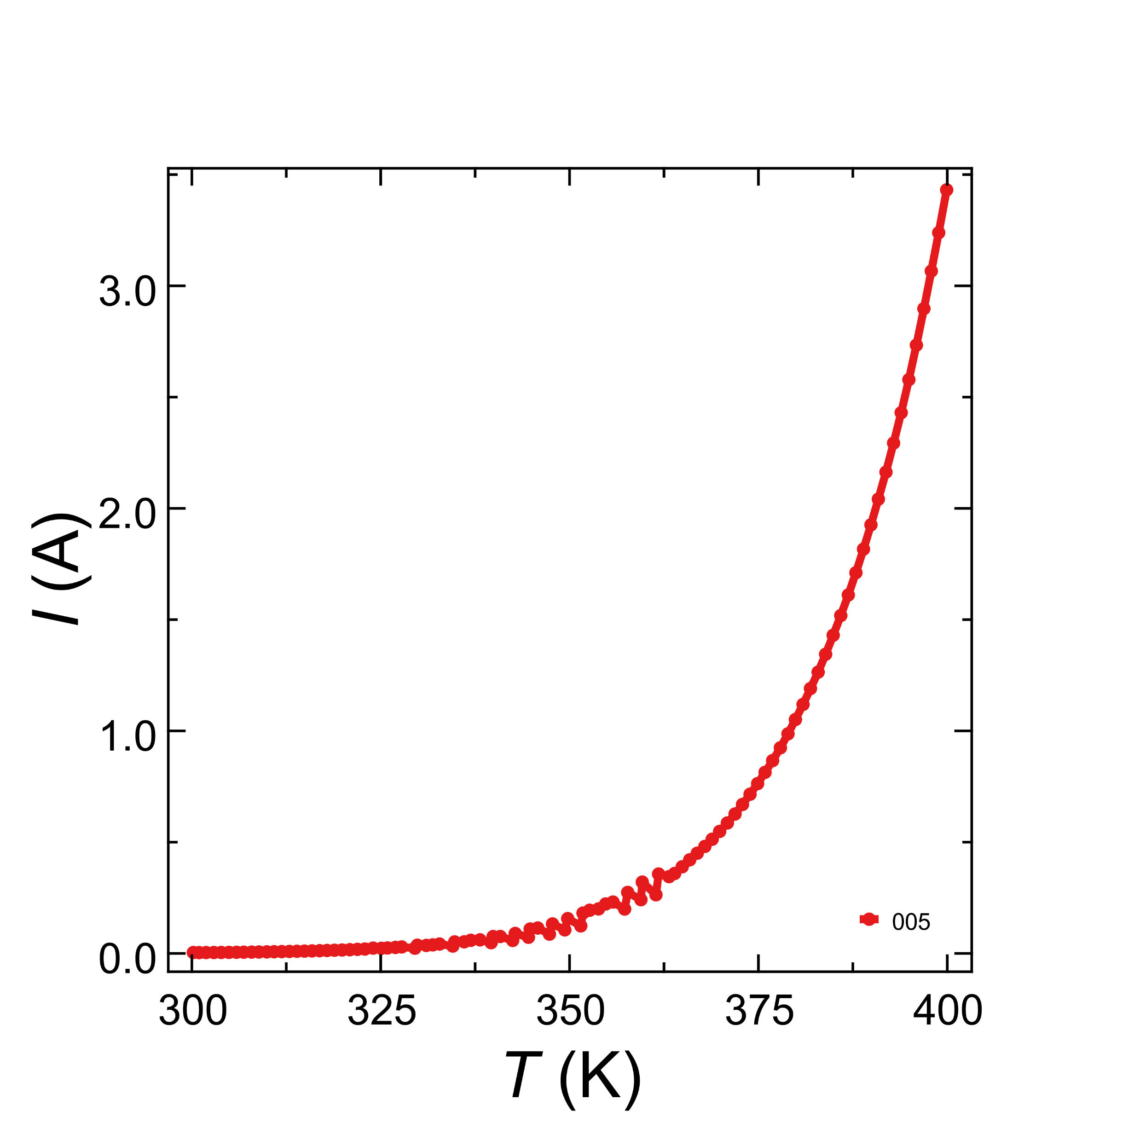
@400K
R_{SD} = 3MΩ
R_{4pt1} = 890kΩ
R_{4pt2} = 430kΩ

Slide 3
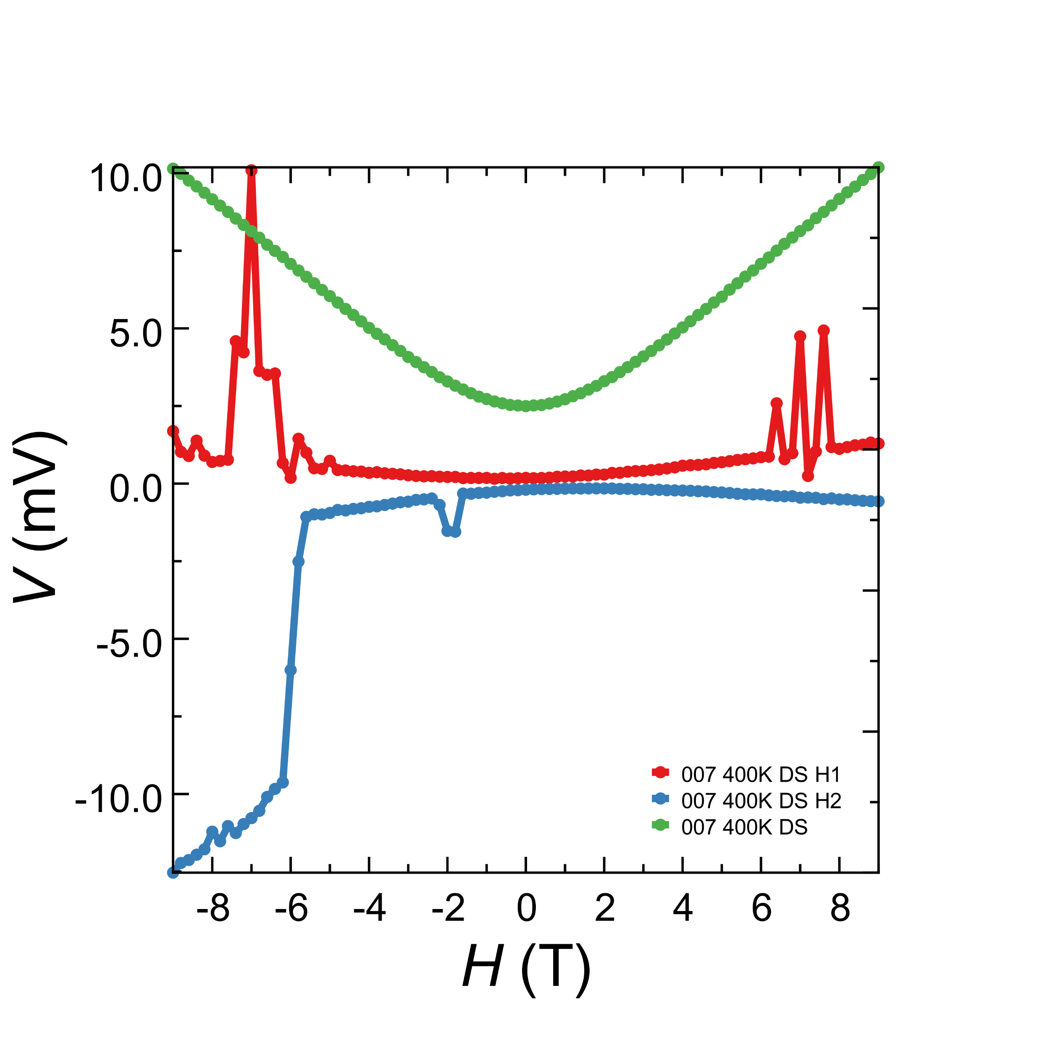
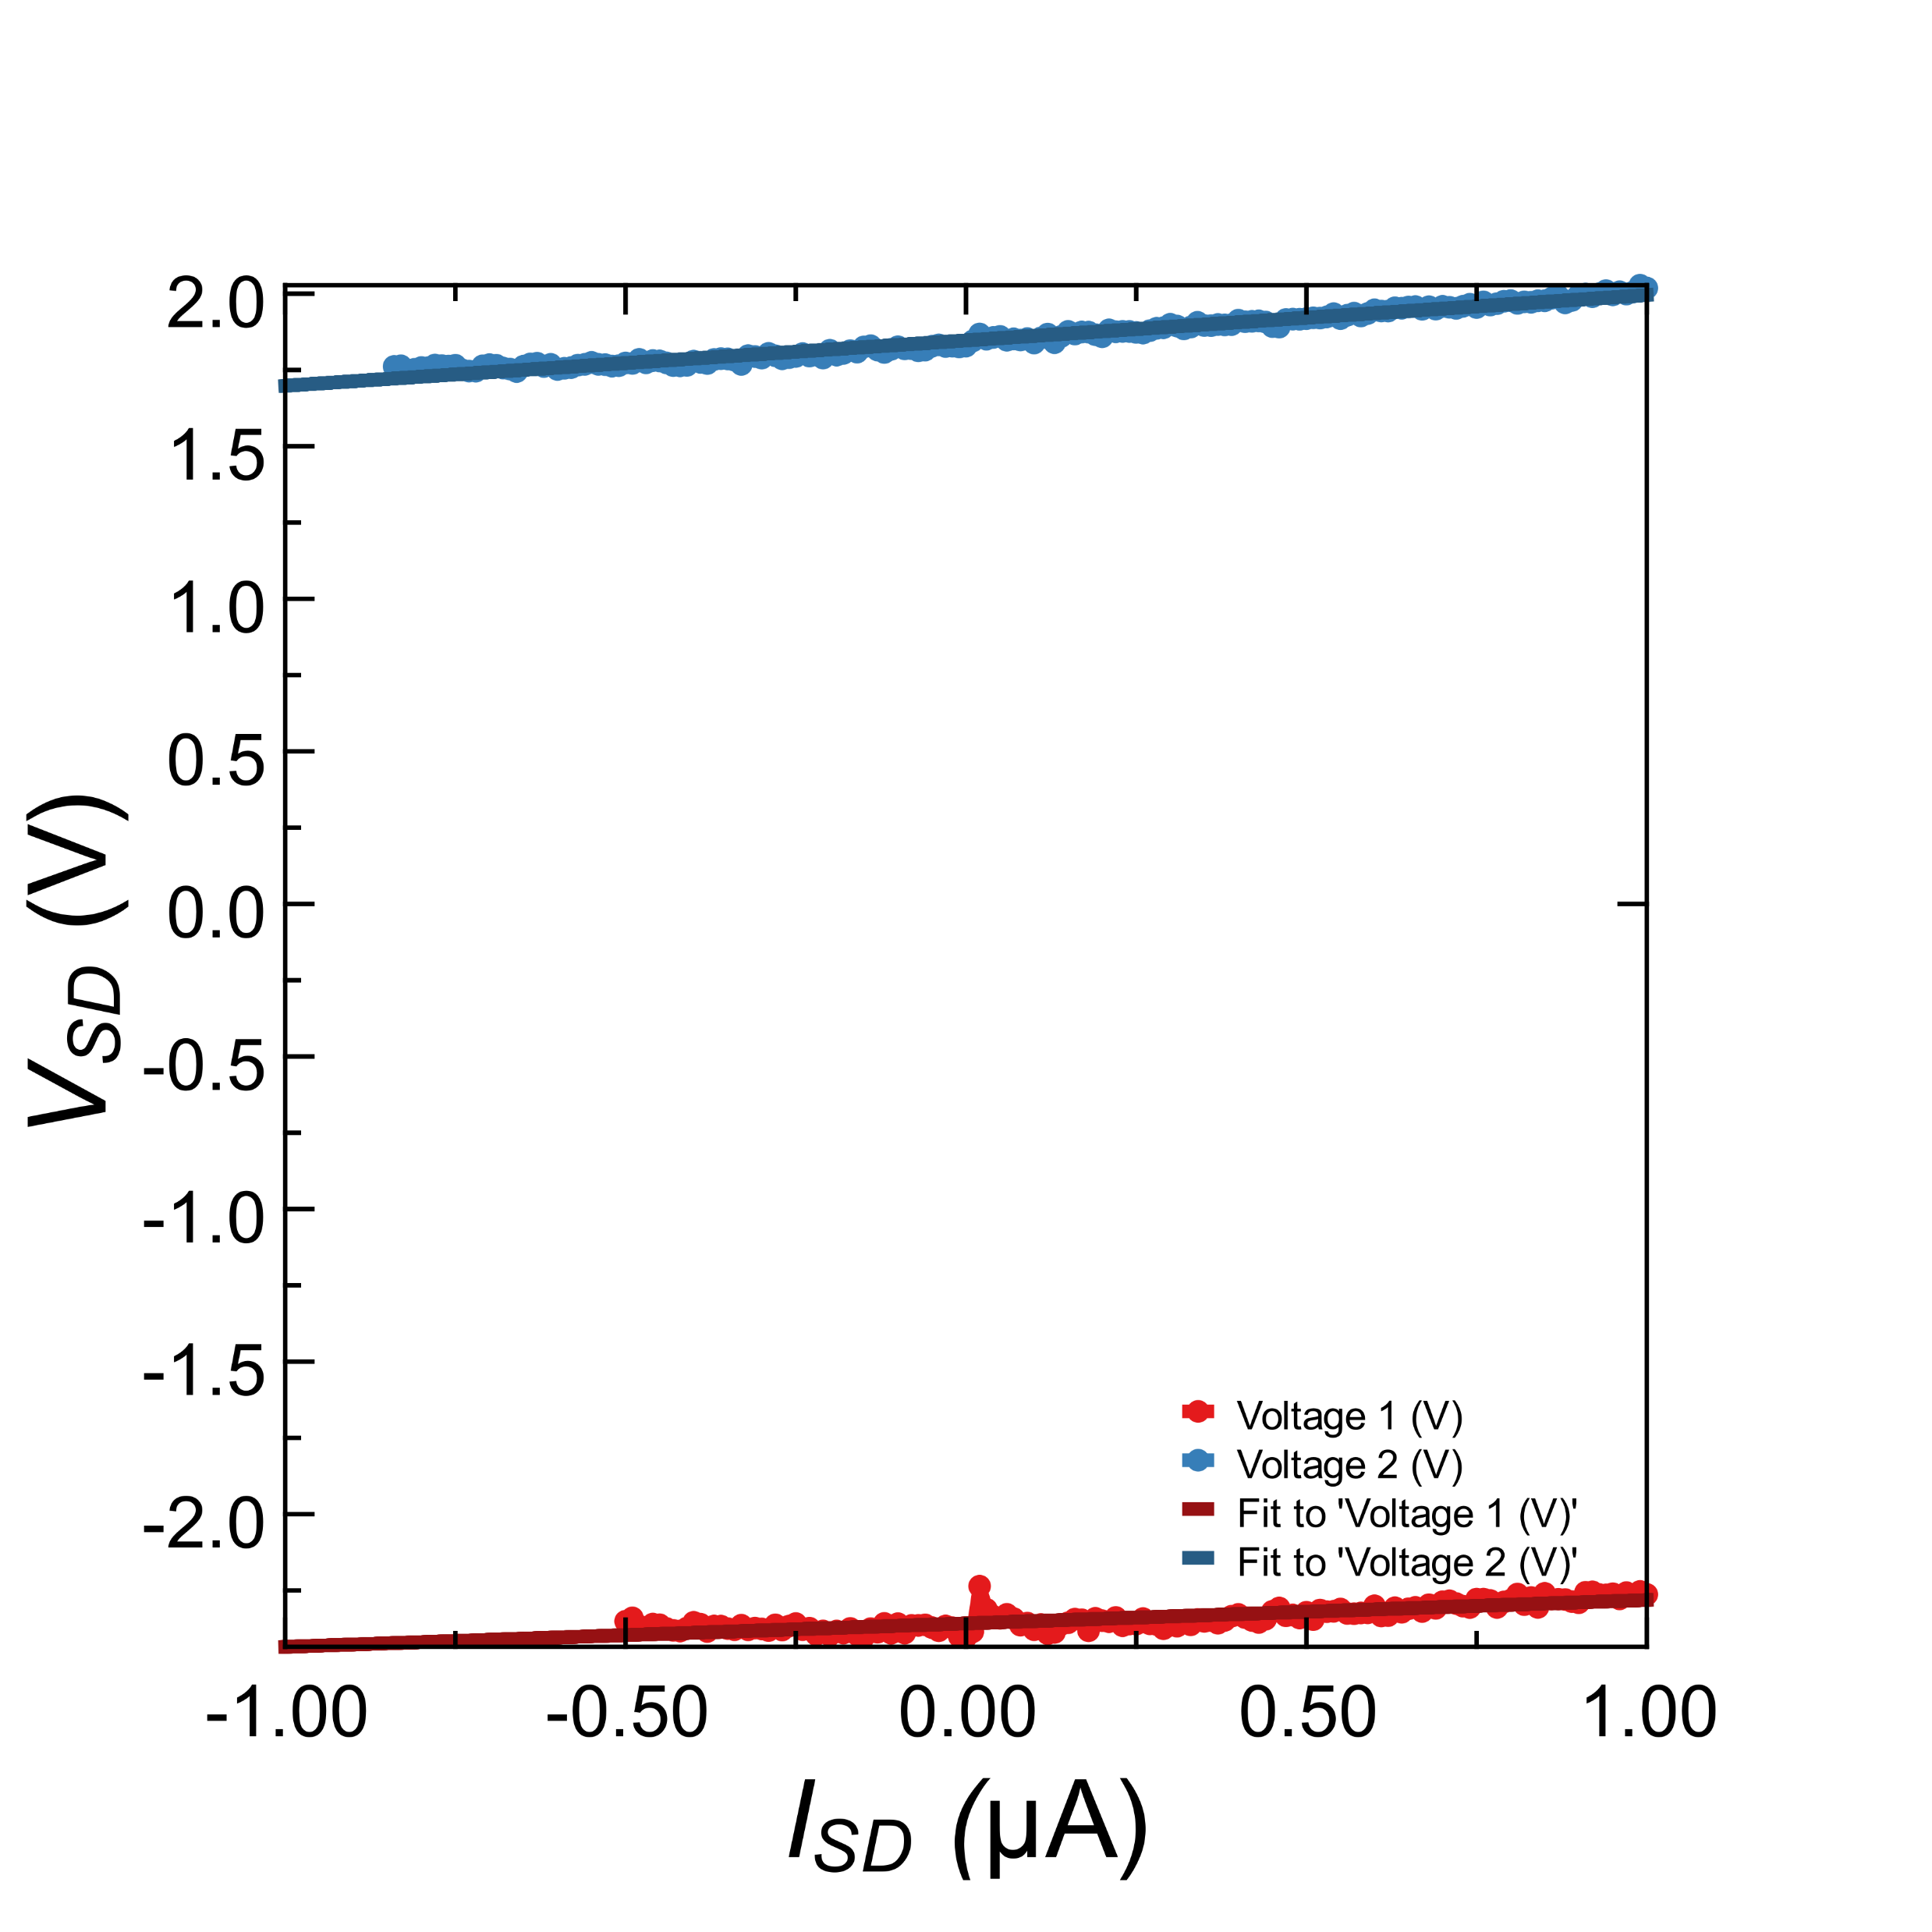
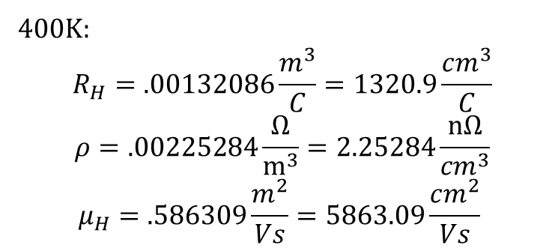
400K:
$$R_{H}=.00132086\frac{m^{3}}{C}=1320.9\frac{cm^{3}}{C}$$
$$ρ=.00225284\frac{Ω}{m^{3}}=2.25284\frac{nΩ}{{cm}^{3}}$$
$$μ_{H}=.586309\frac{m^{2}}{Vs}=5863.09\frac{cm^{2}}{Vs}$$
Notes:
VvsB=(2.35307e-05+6.45263e-05)/2 = 0.0000440285
i=1*10⁻⁹;
t=30*10⁻⁹;
Rh=t*VvsB/I
R4pt(B=0) = 279578 Ohms
Volt_spacing = 30 nm
Width = 20 nm

Slide 4
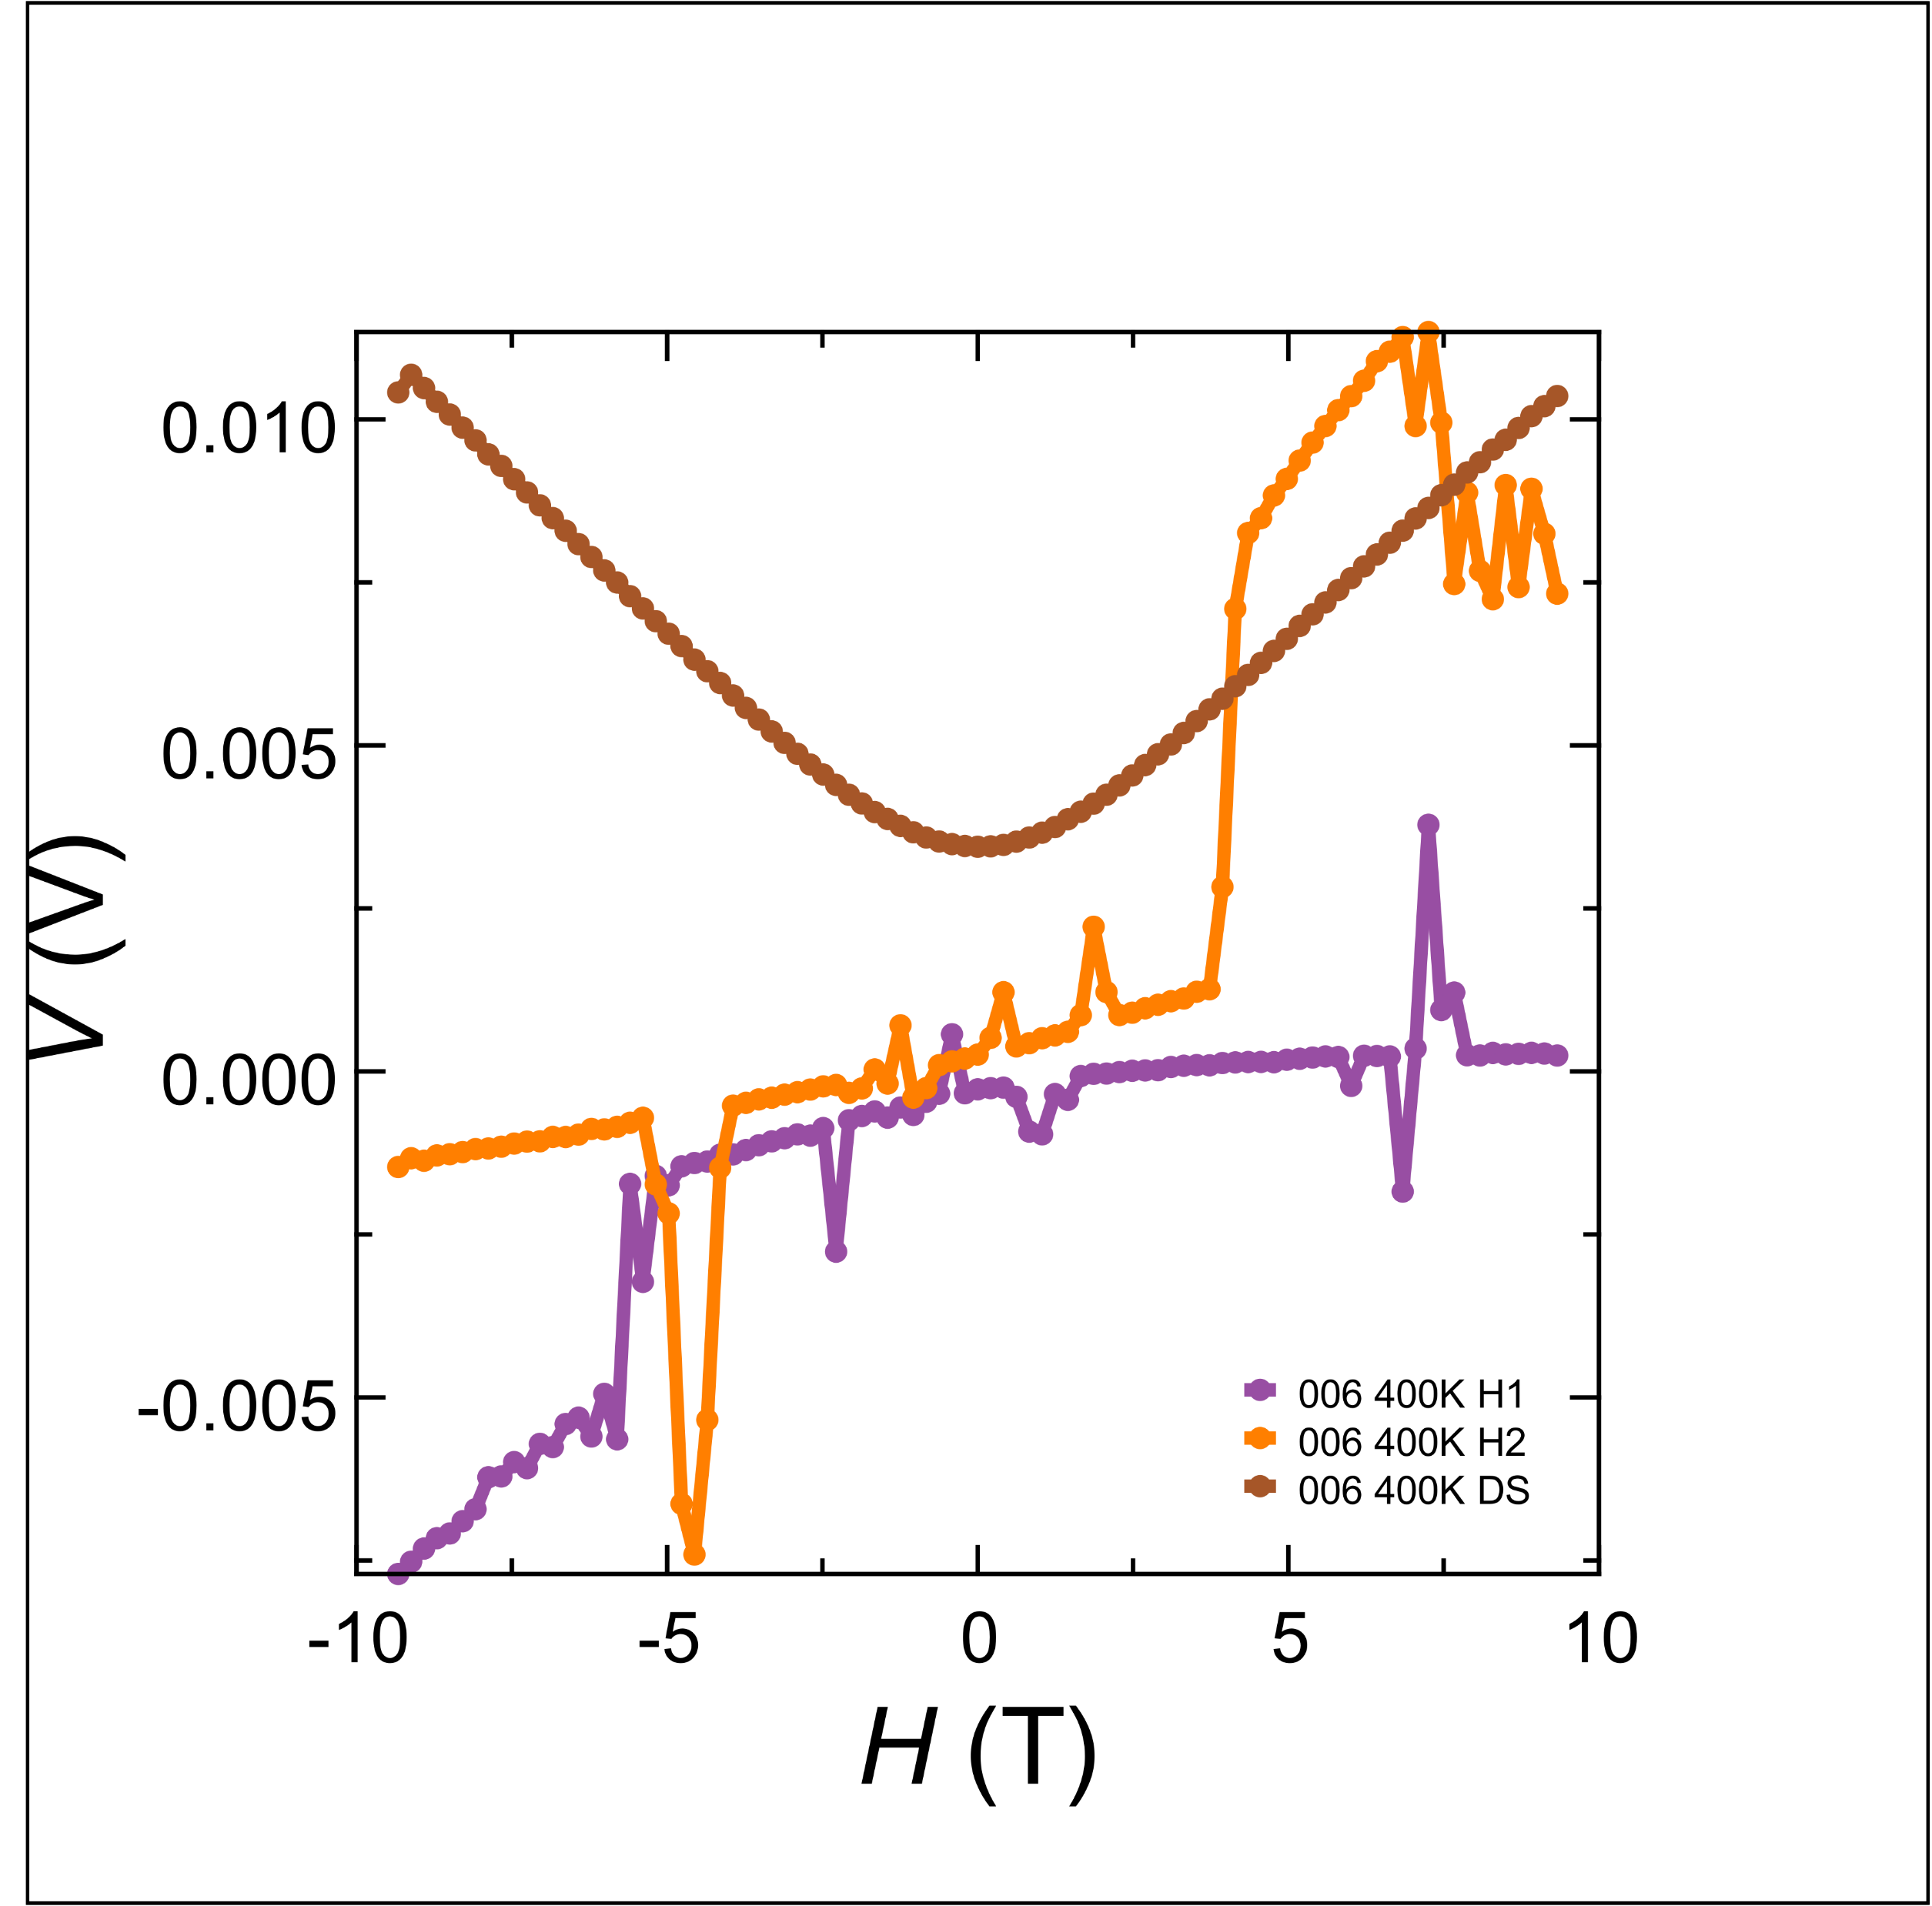
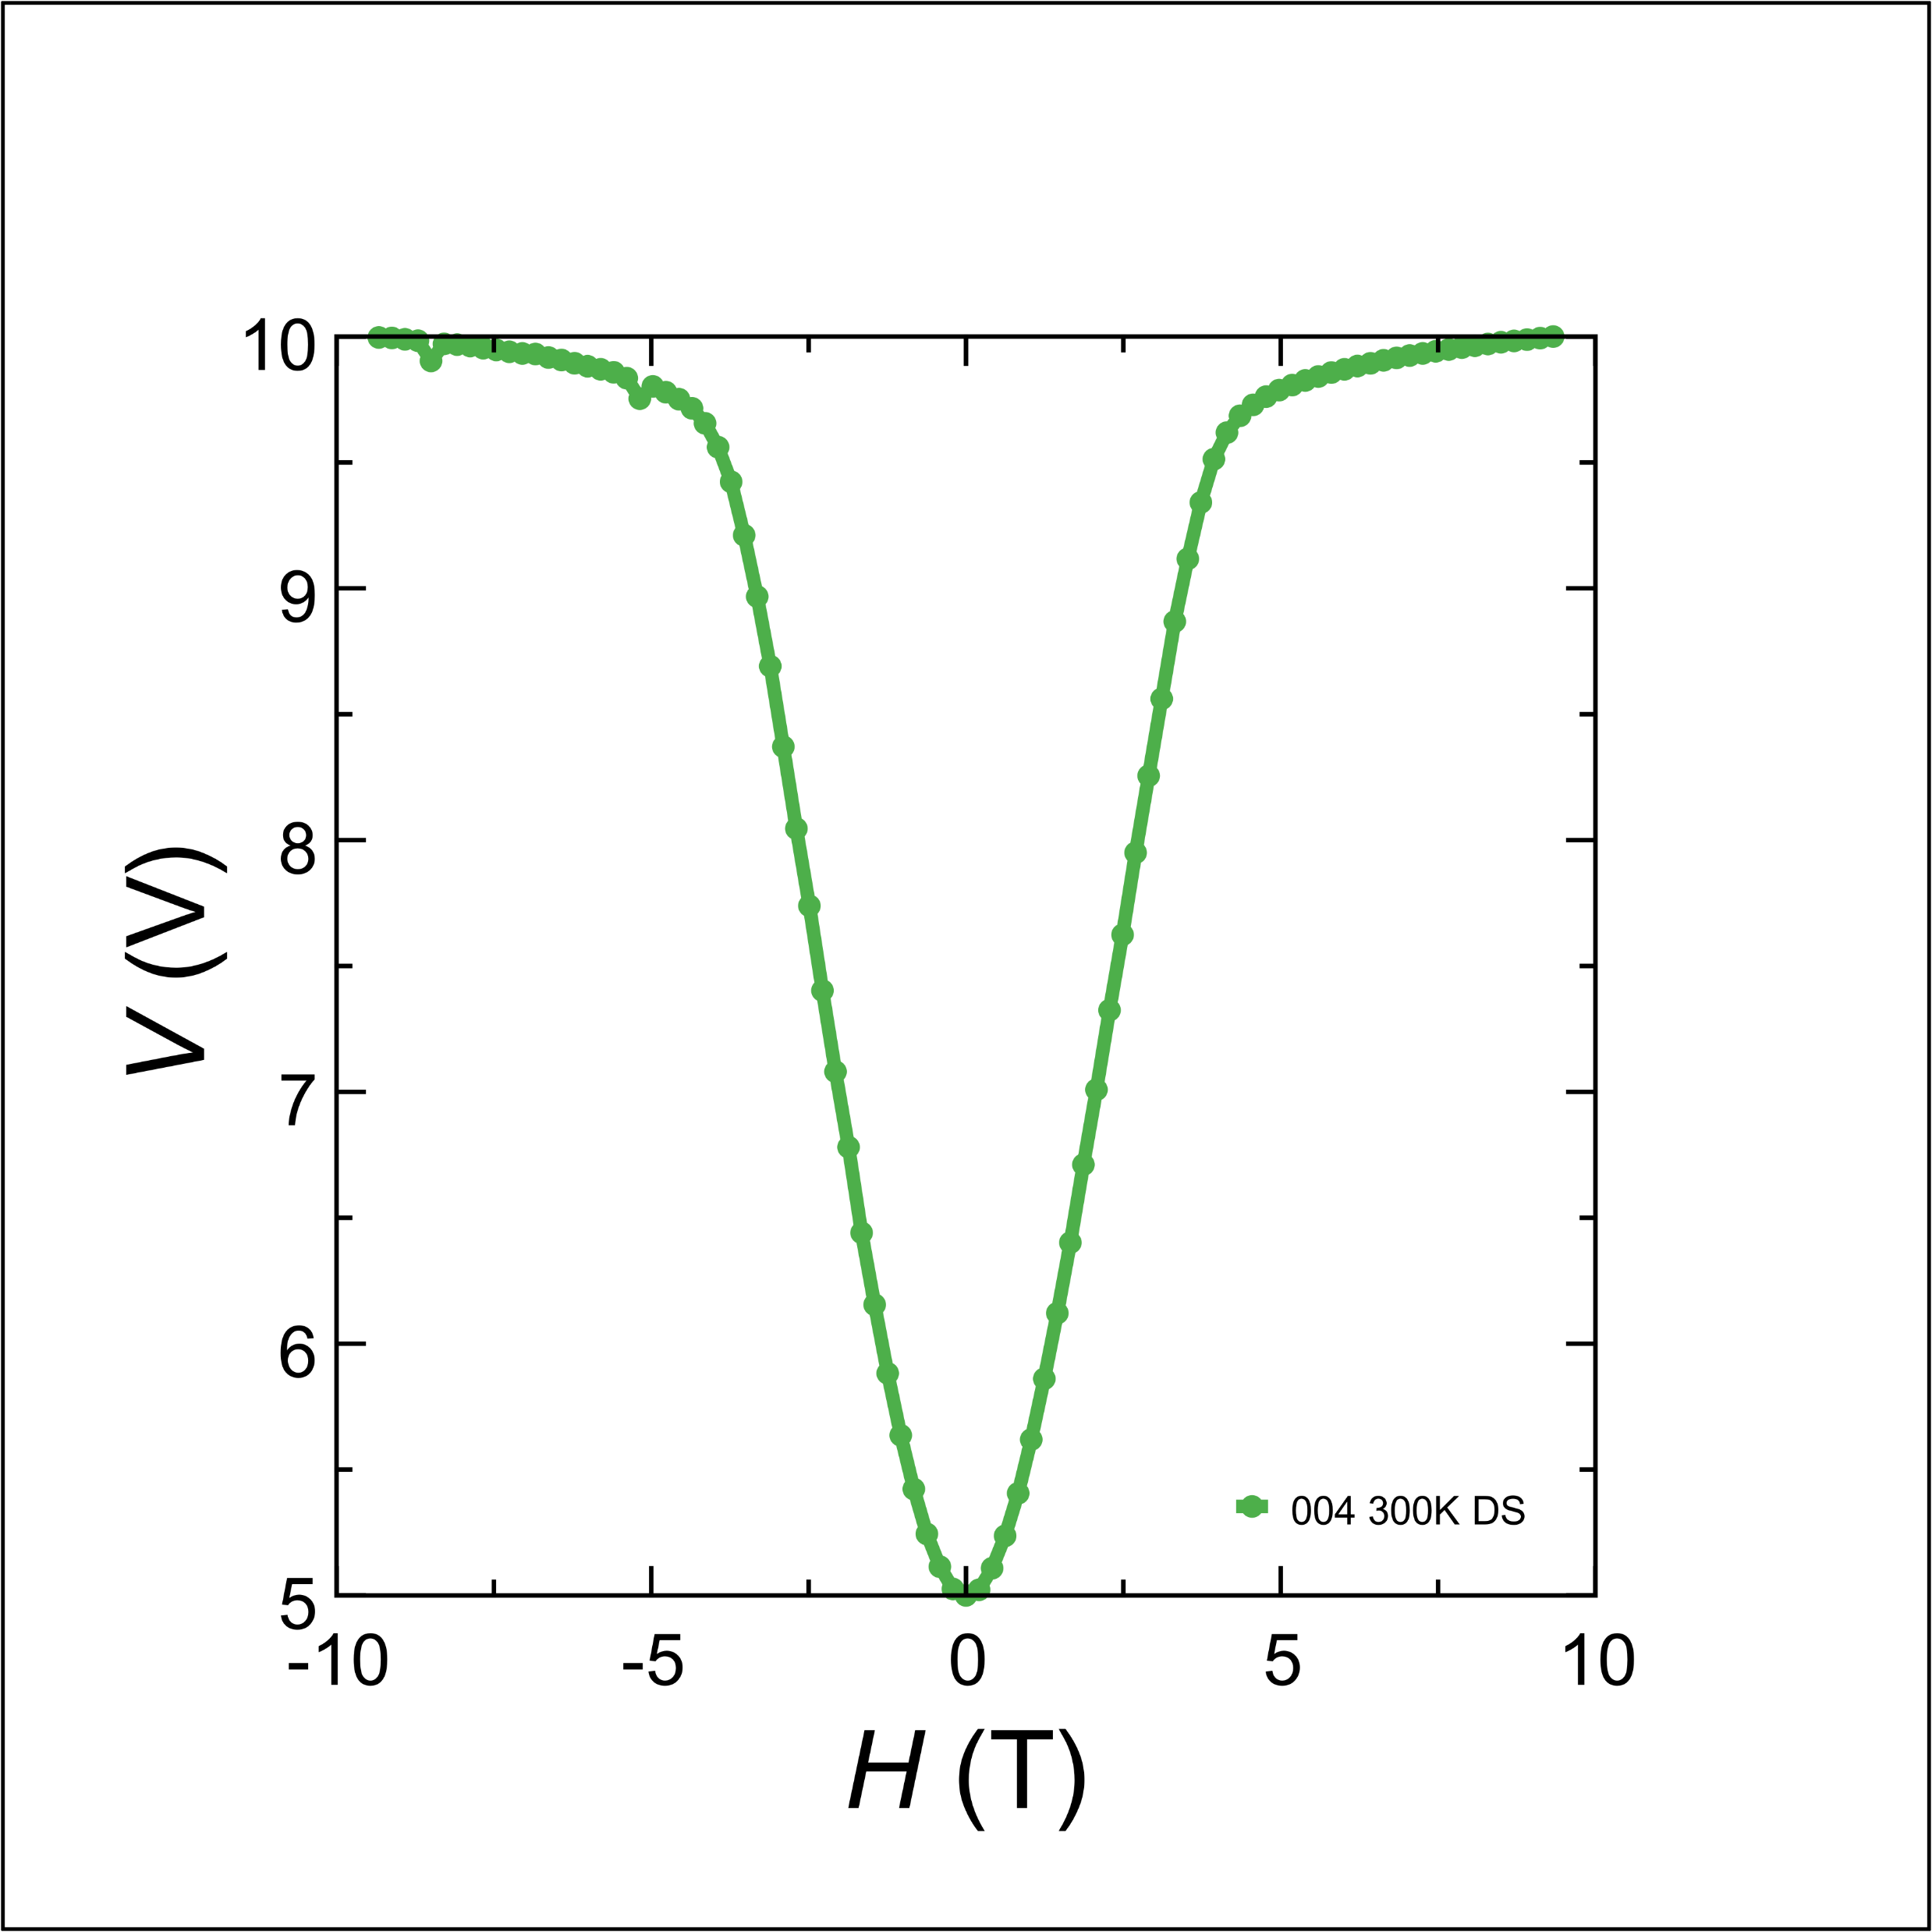
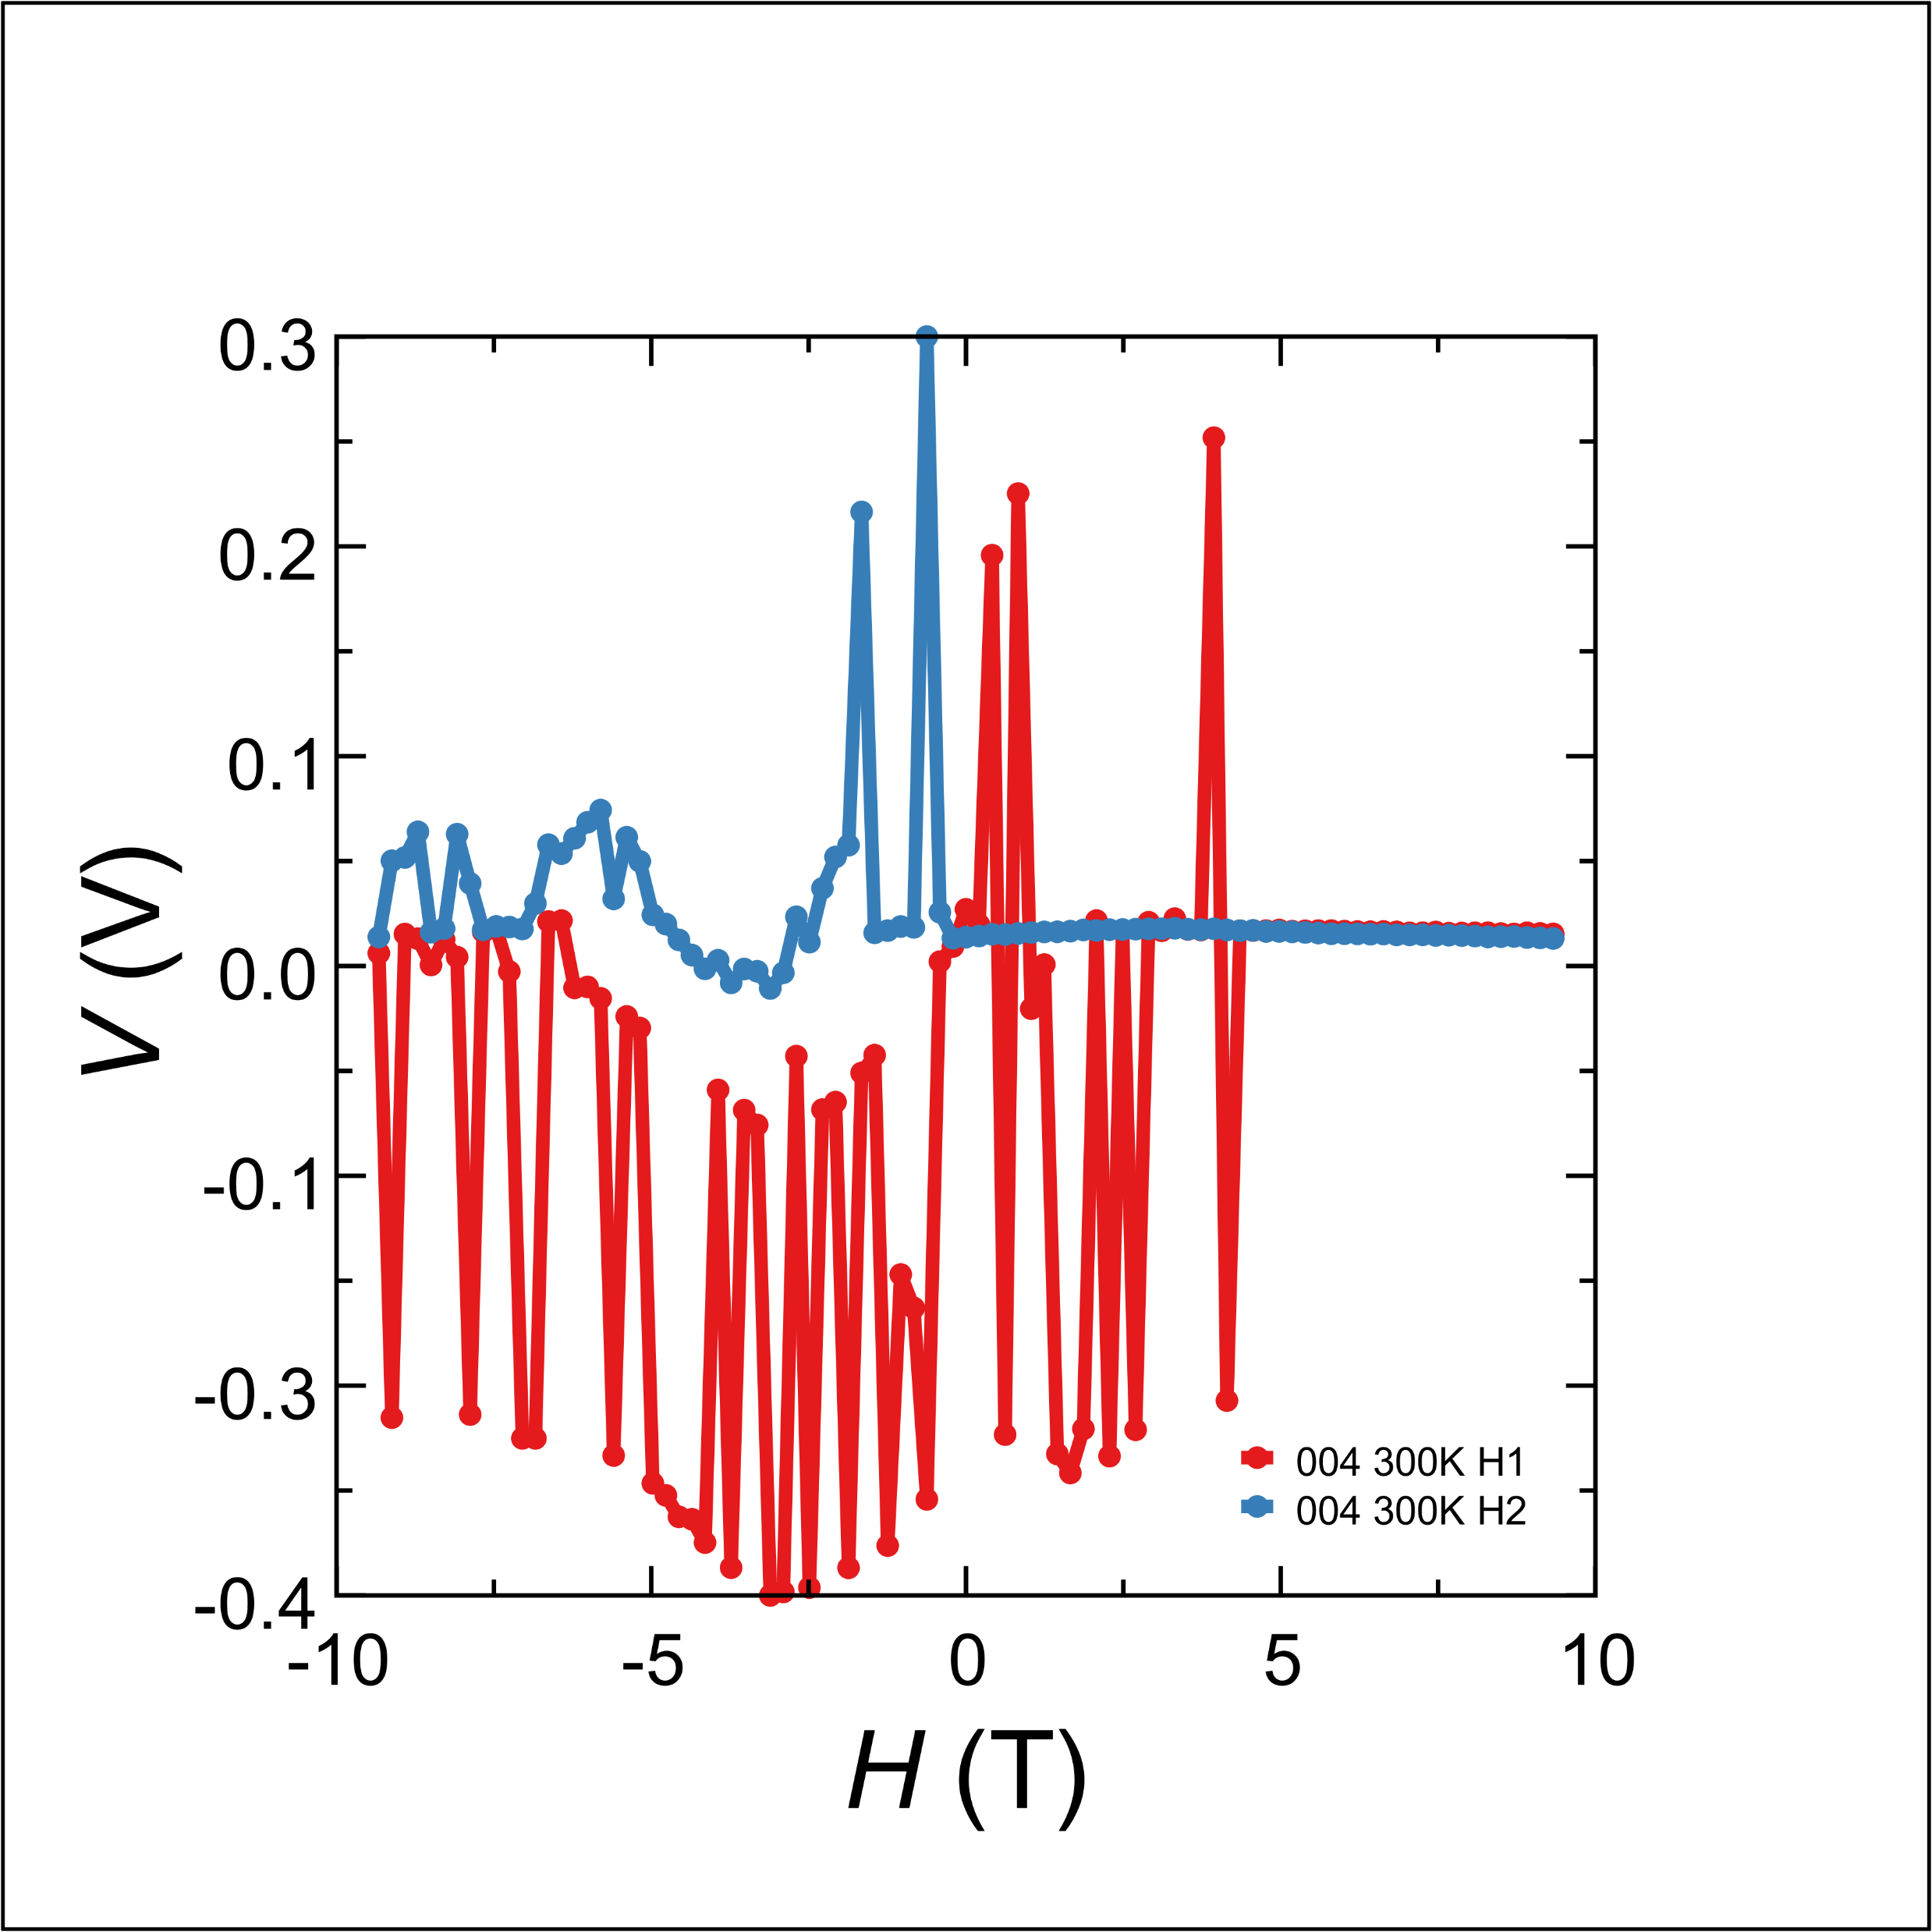
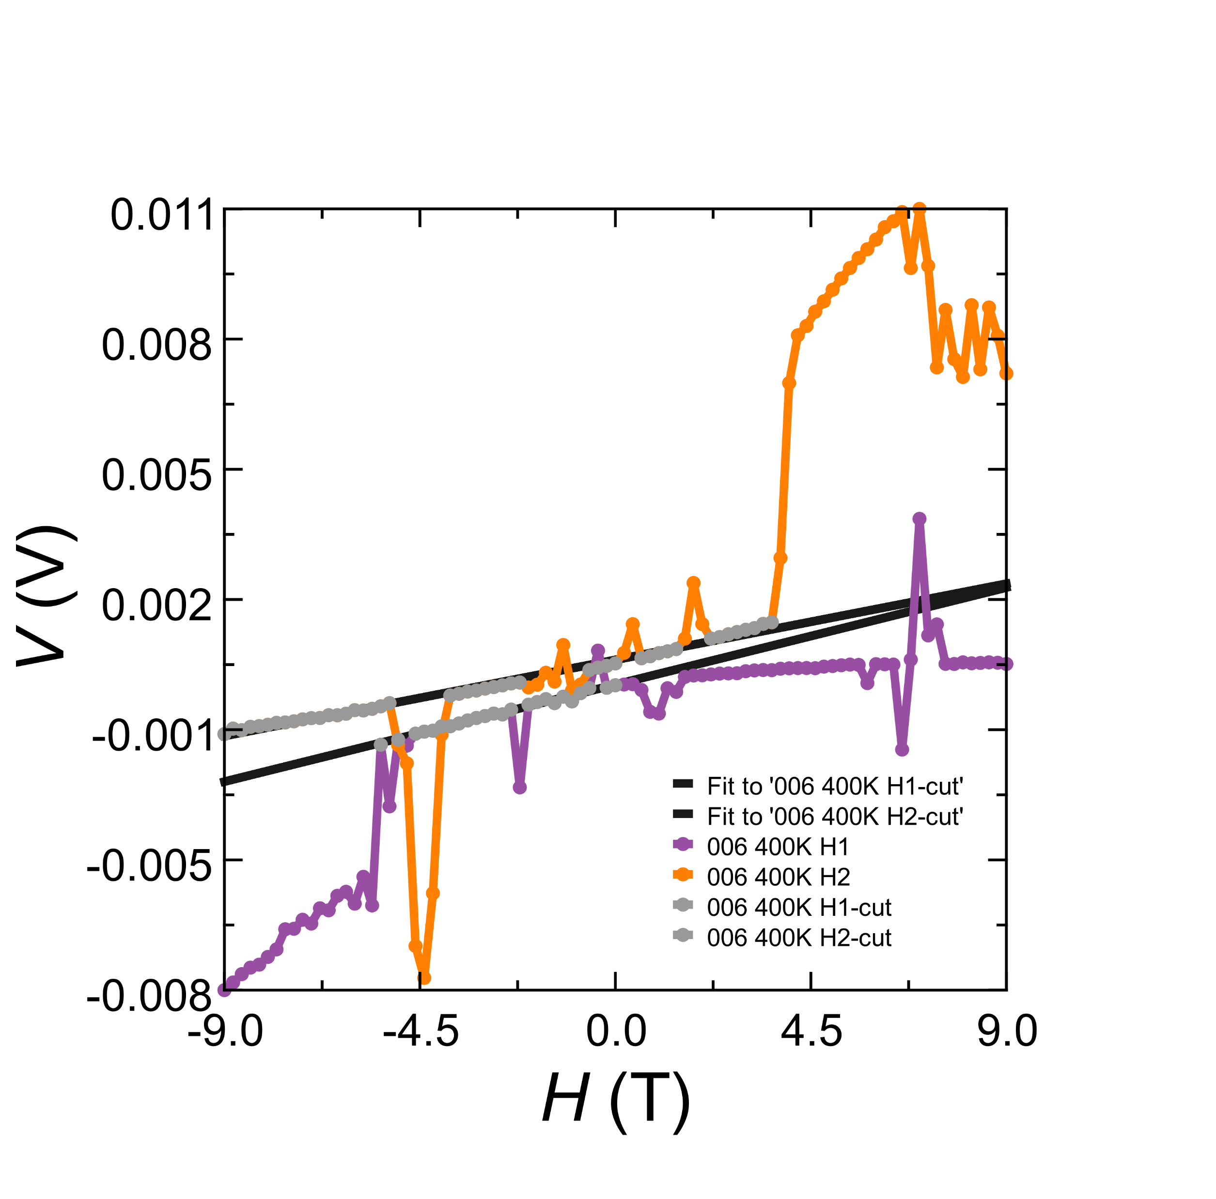
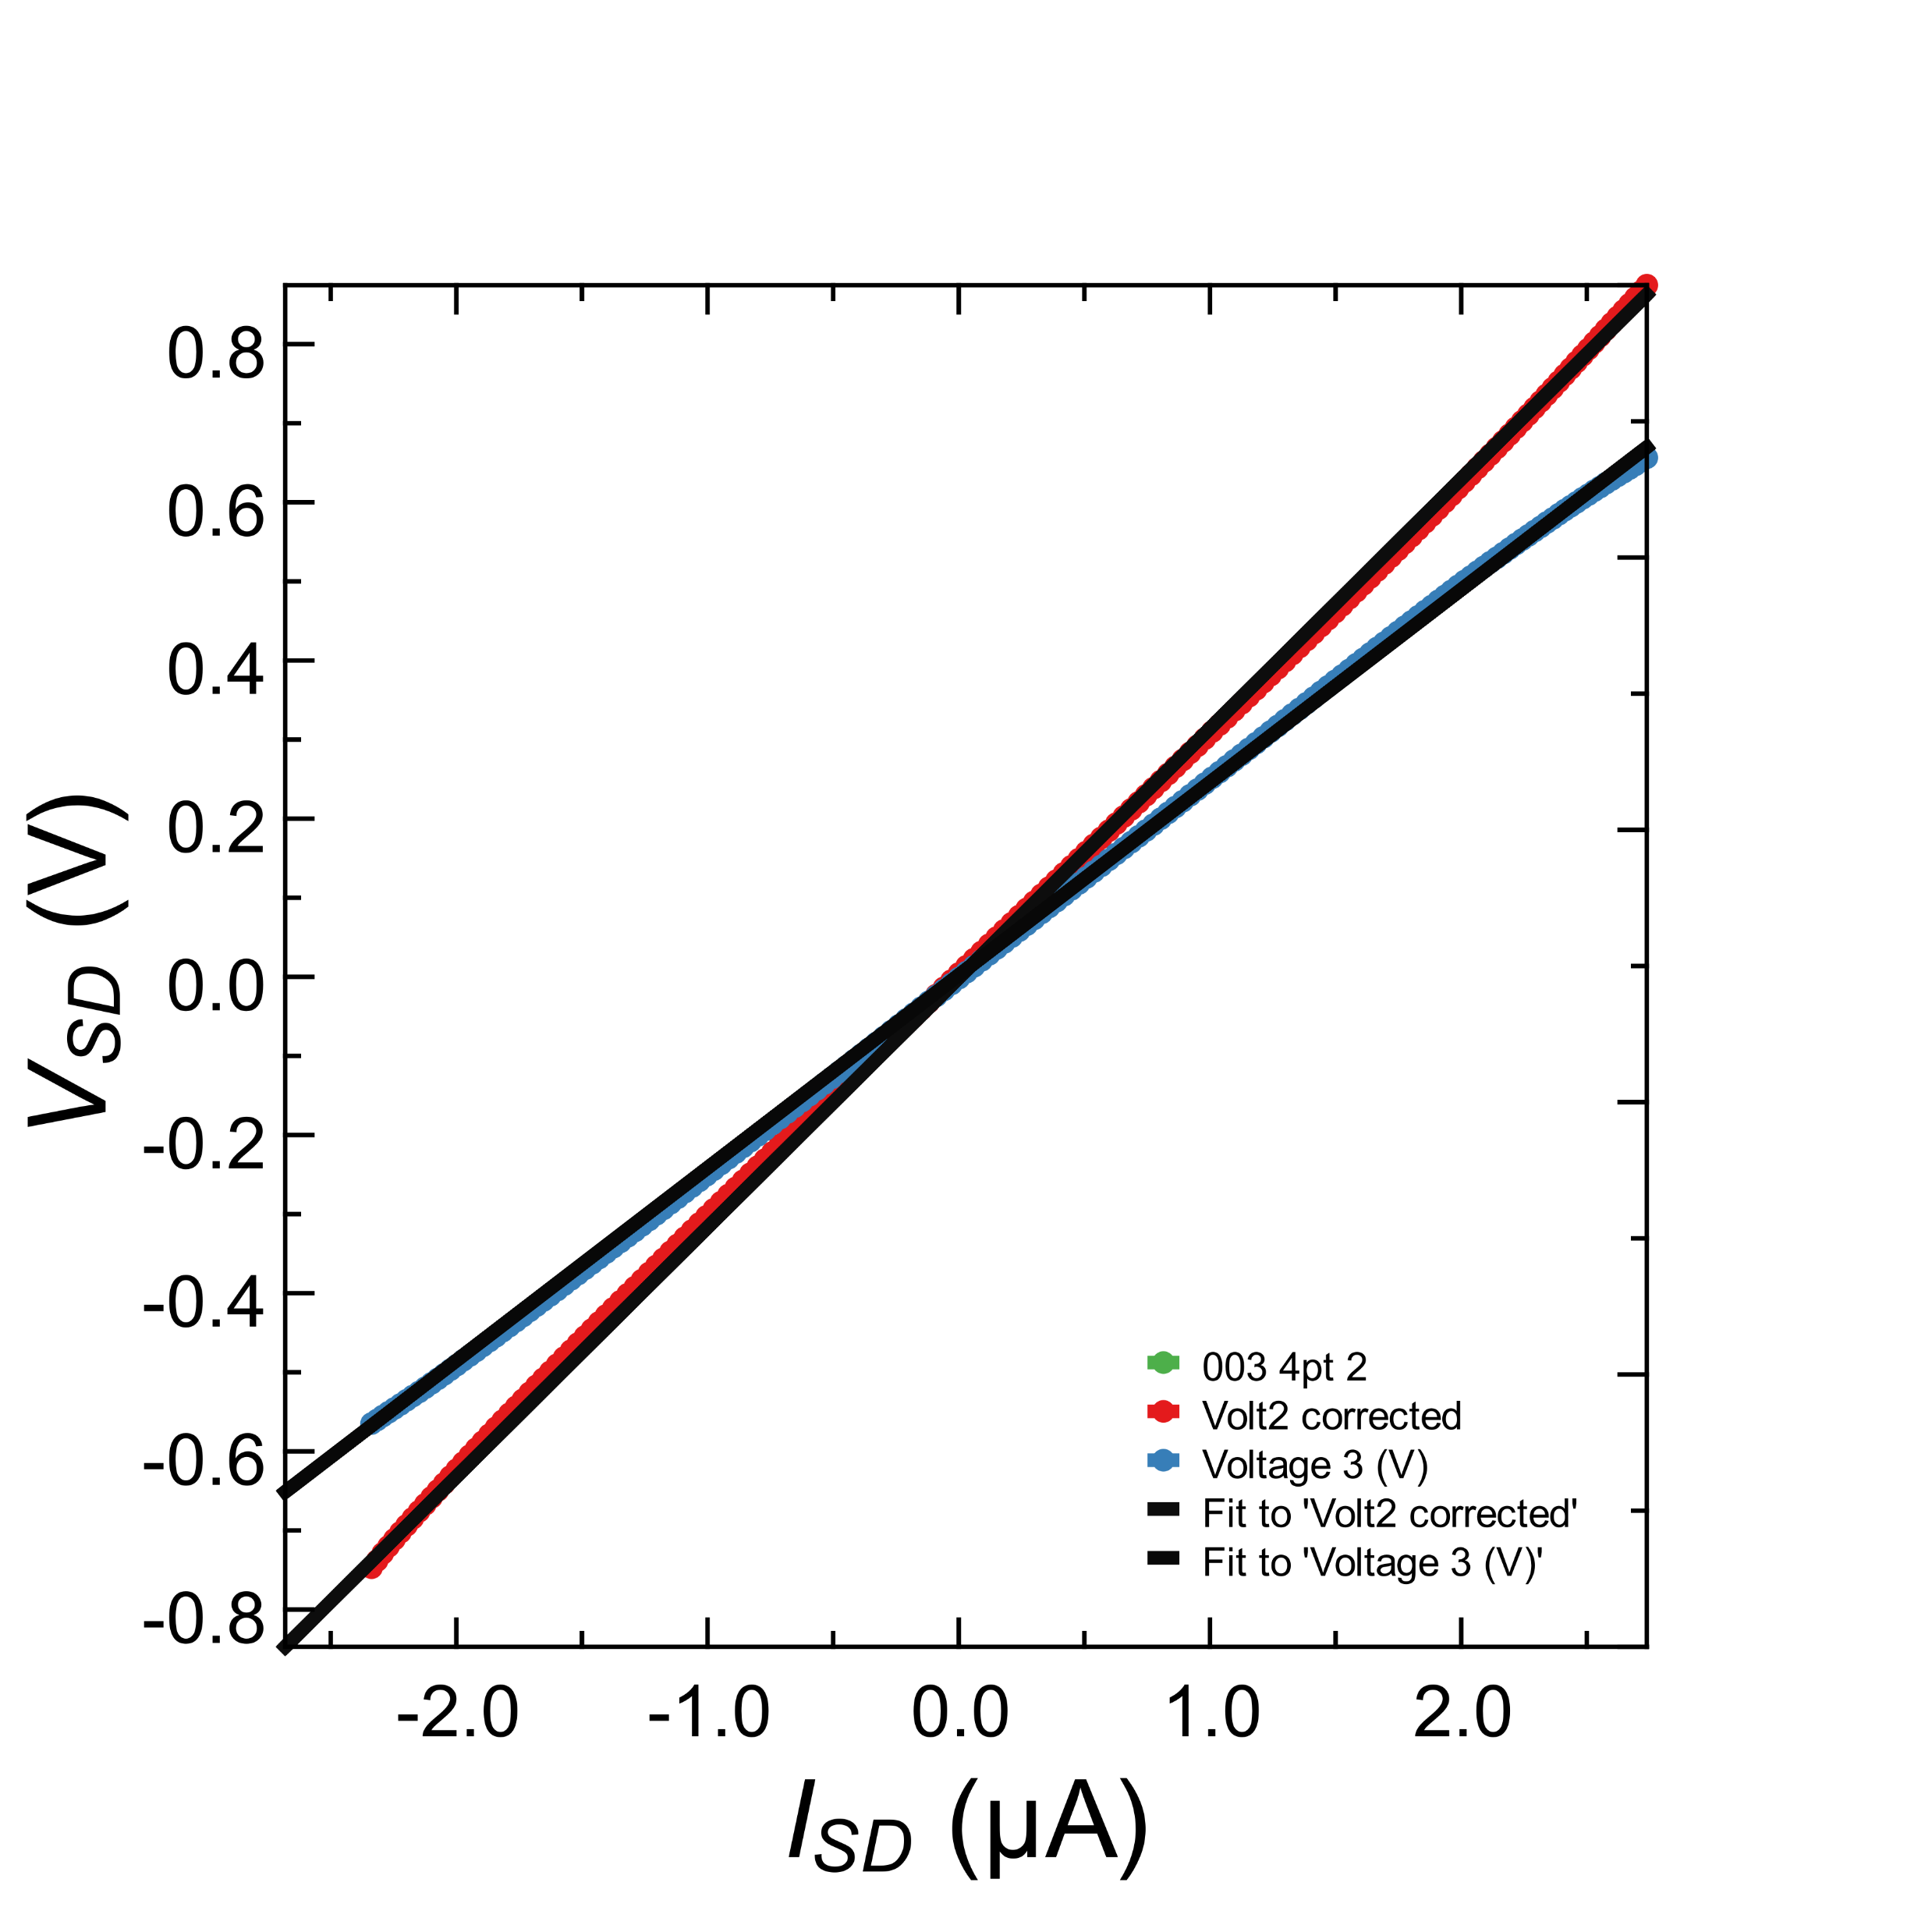
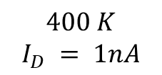
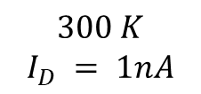
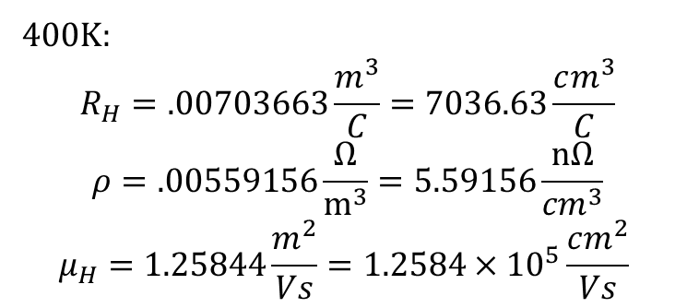
$$400 K$$
$$I_{D} = 1nA$$
Sample “Parallelogram” 1
$$300 K$$
$$I_{D} = 1nA$$
400K:
$$R_{H}=.00703663\frac{m^{3}}{C}=7036.63\frac{cm^{3}}{C}$$
$$ρ=.00559156\frac{Ω}{m^{3}}=5.59156\frac{nΩ}{{cm}^{3}}$$
$$μ_{H}=1.25844\frac{m^{2}}{Vs}=1.2584×{10}^{5}\frac{cm^{2}}{Vs}$$
Notes:
VvsB=(0.000262828+0.000206281)/2;
i=1*10⁻⁹;
t=30*10⁻⁹;
Rh=t*VvsB/I
R4pt(B=0) = 279578 Ohms
Volt_spacing = 30 nm
Width = 20 nm

Slide 5


Slide 6
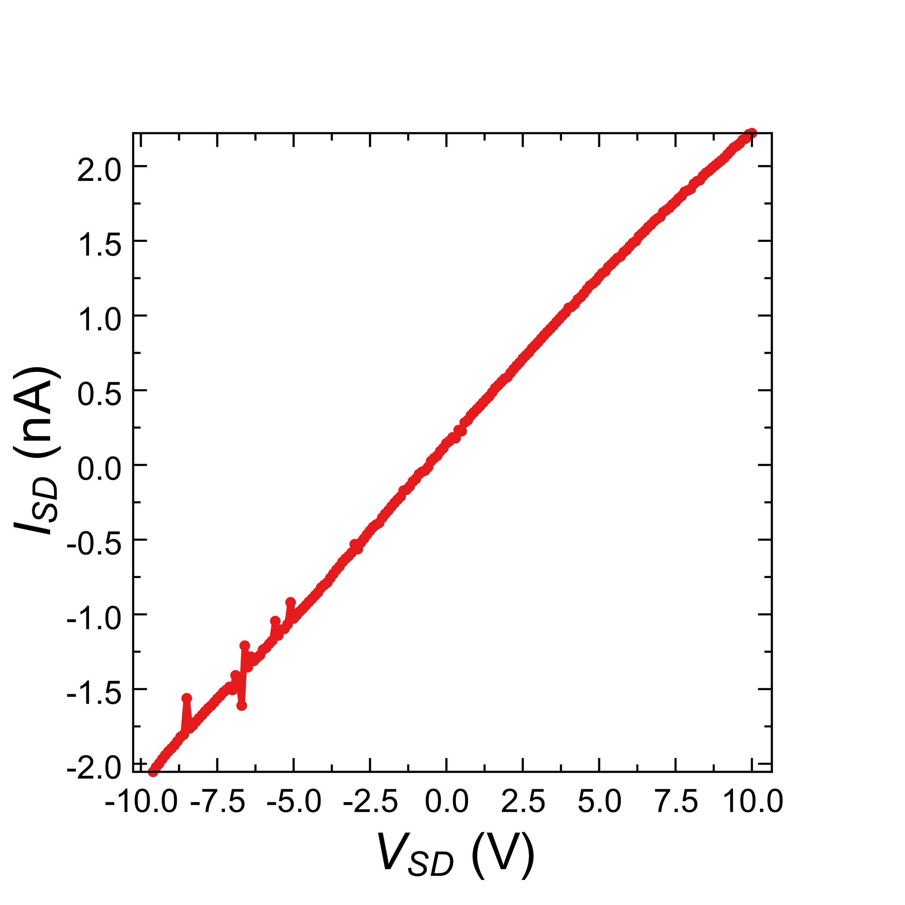
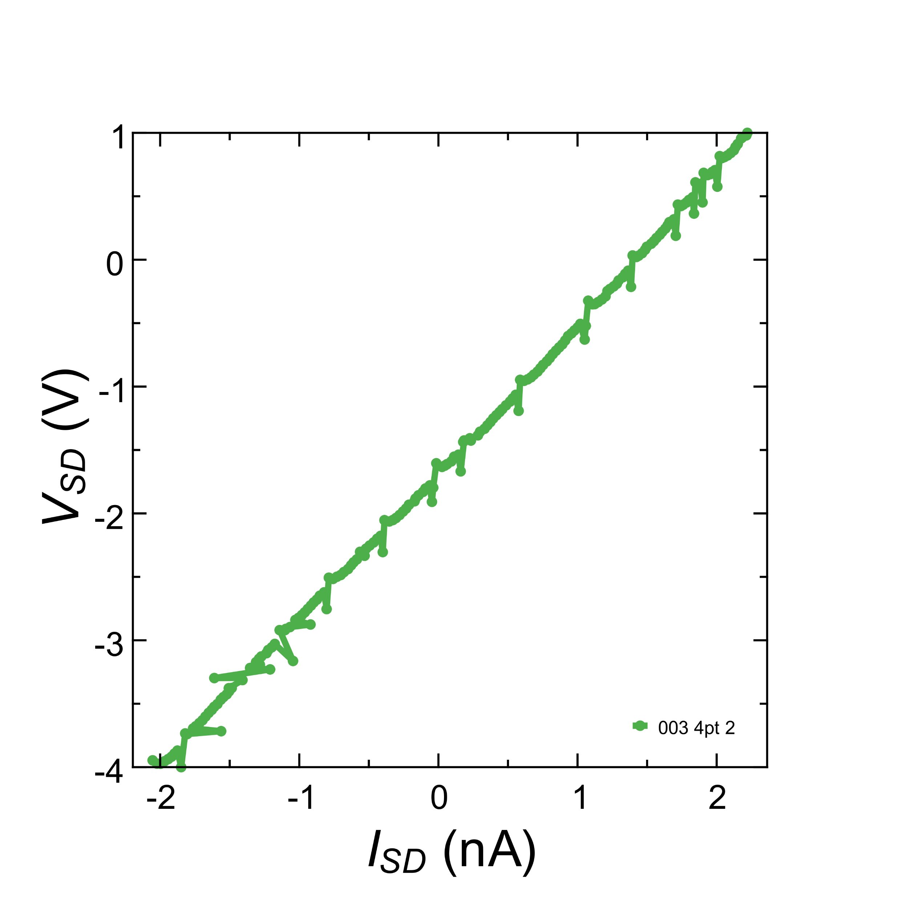
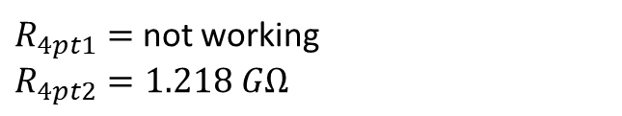

Sample “Parallelogram” 2
$R_{4pt1}=$ not working
$R_{4pt2}=1.218 GΩ$
$$R_{SD}=4.512 GΩ$$

Slide 7
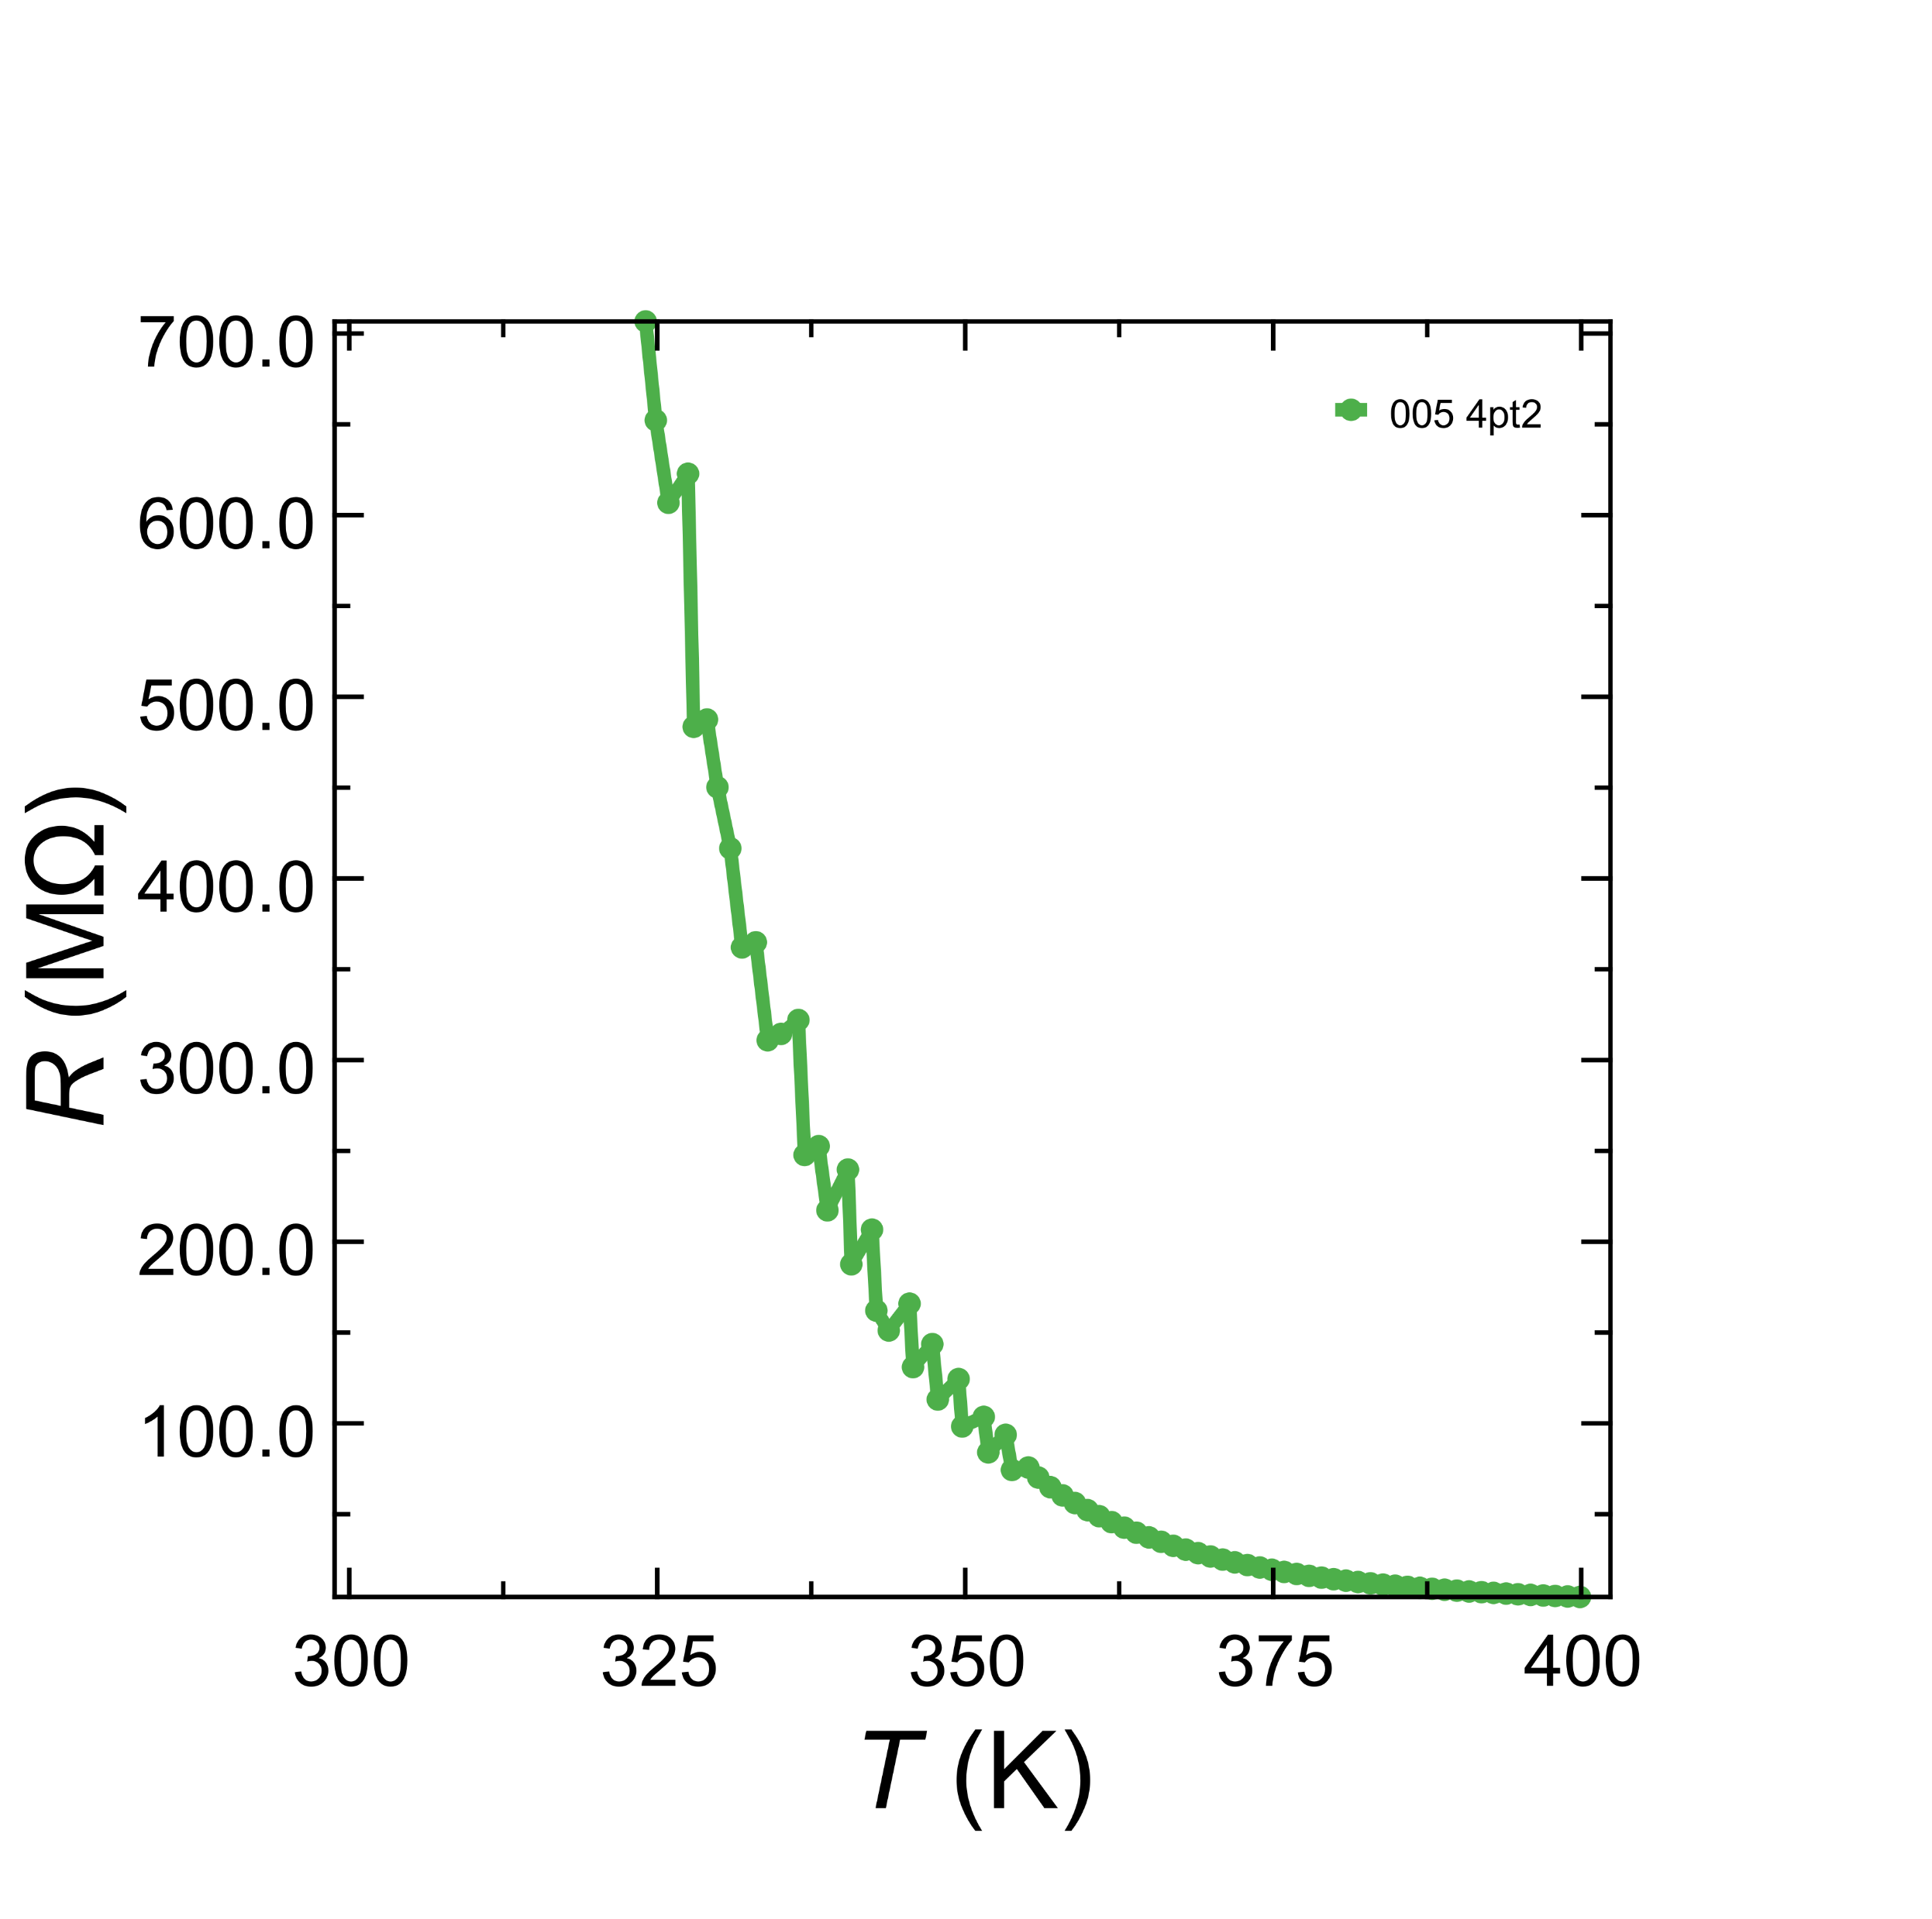
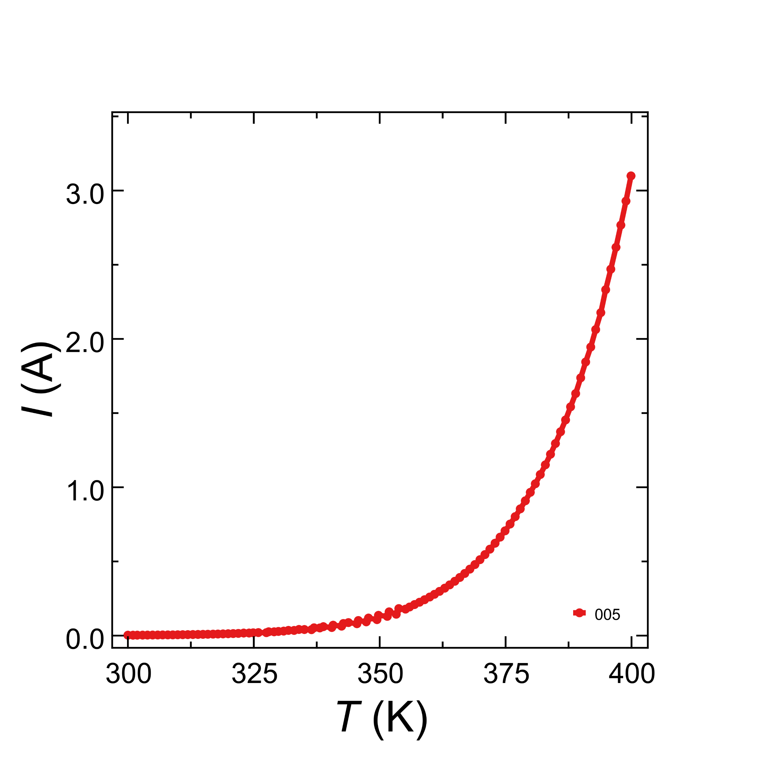
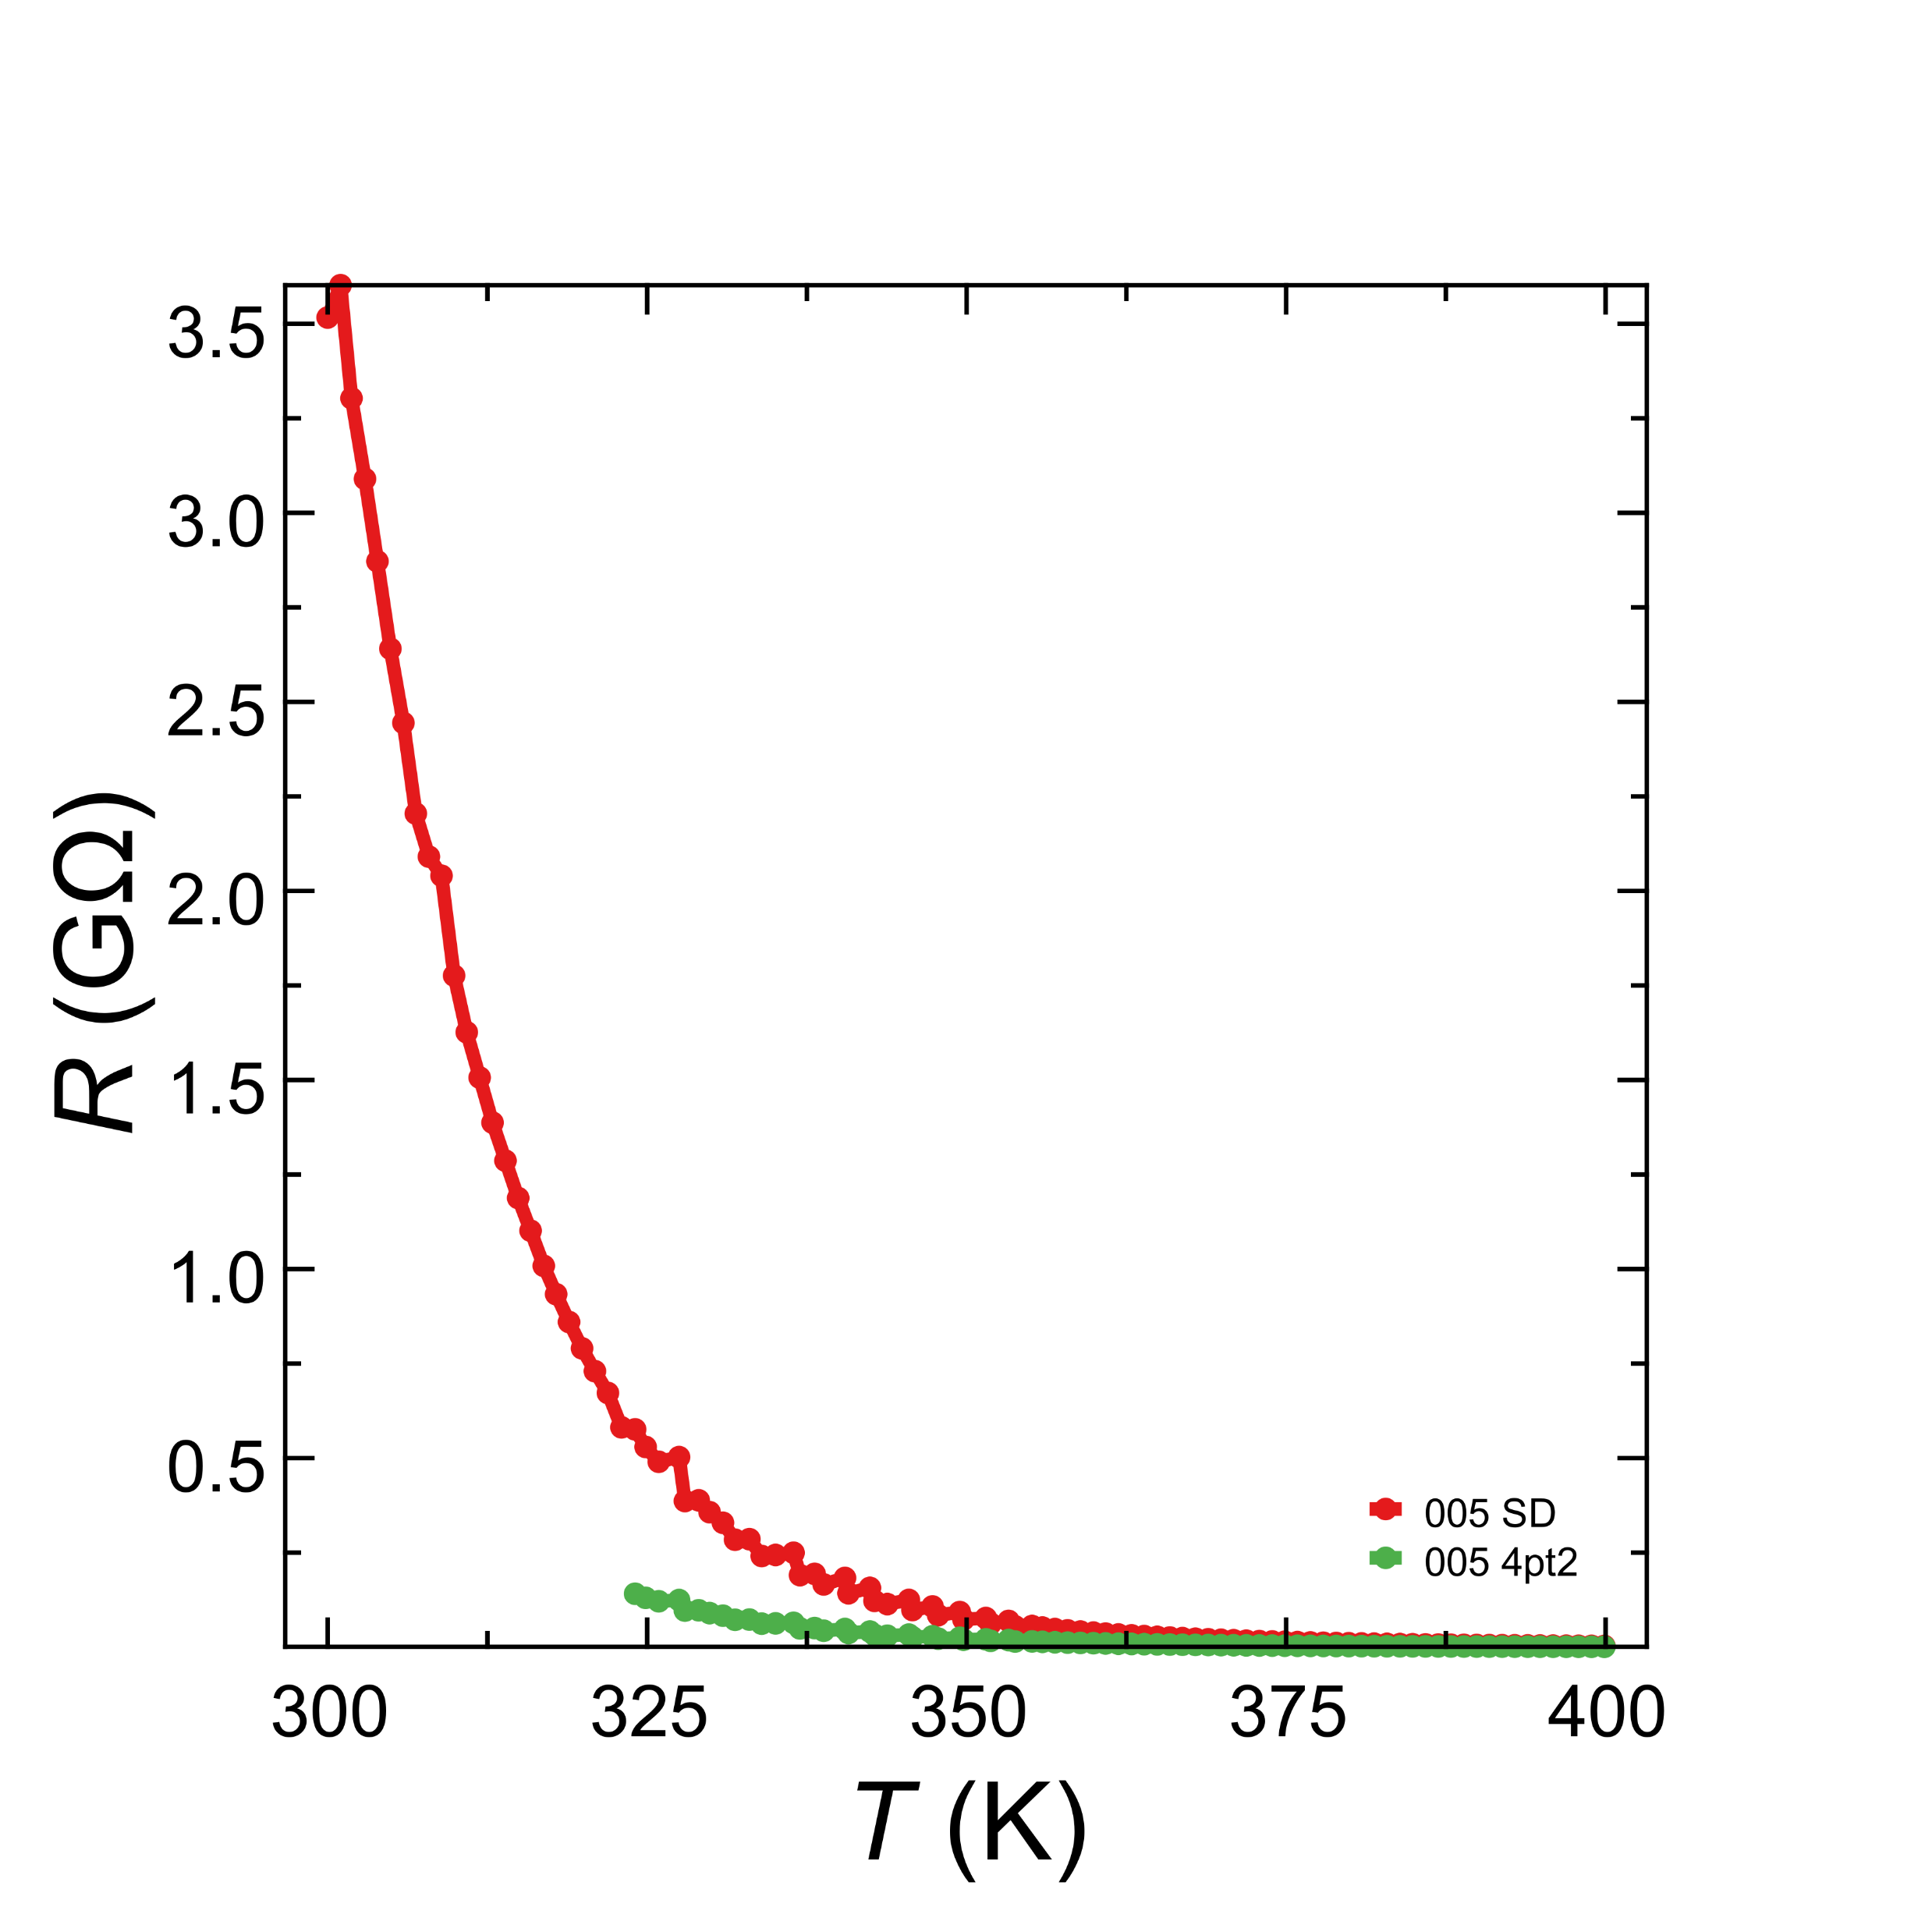
@400K
R_{SD} = .23MΩ
R_{4pt2} = 890kΩ

Slide 8
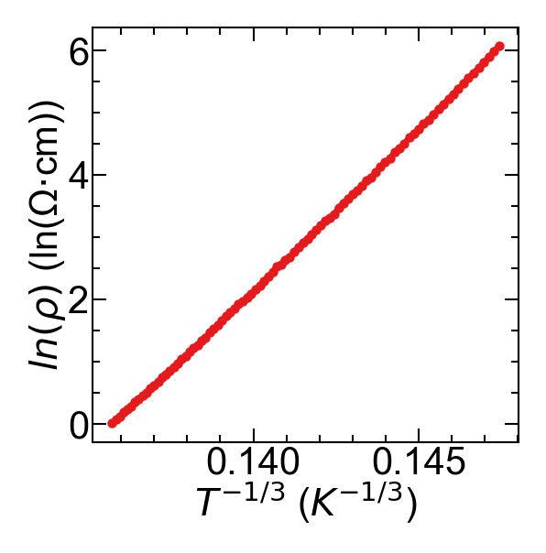
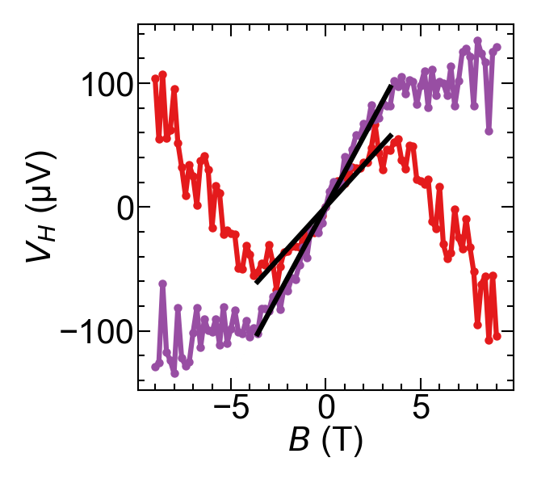
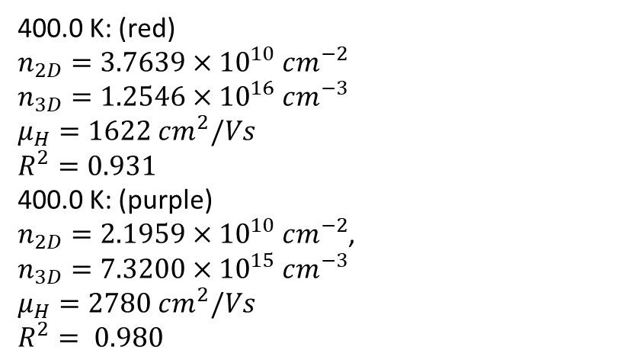
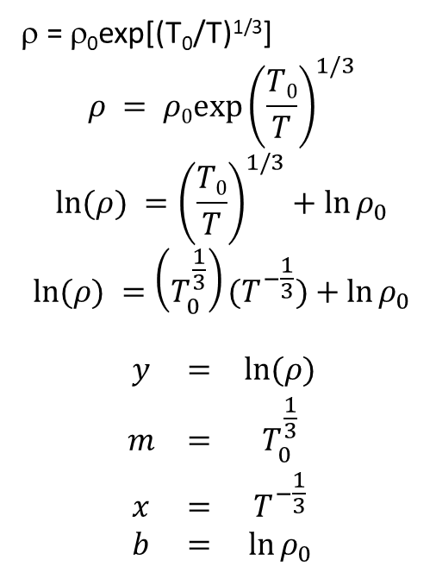
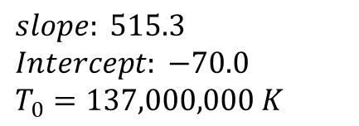
Sample: Small trapezoid A
$slope: 515.3$
$Intercept: −70.0$
$T_{0}=137,000,000 K$
ρ = ρ₀exp[(T₀/T)^{1/3}]
$$ρ = ρ0exp⁡{\left(\frac{T0}{T}\right)}^{1/3}$$
$$\ln{(ρ)} ={\left(\frac{T0}{T}\right)}^{1/3}+\ln{ρ_{0}}$$
$$\ln{(ρ)} =\left(T_{0}^{\frac{1}{3}}\right)(T^{−\frac{1}{3}})+\ln{ρ_{0}}$$
$$\begin{matrix}y & = & \ln{(ρ)} \\ m & = & T_{0}^{\frac{1}{3}} \\ x & = & T^{−\frac{1}{3}} \\ b & = & \ln{ρ_{0}}\end{matrix}$$
Current 1nA
400.0 K: (red)
$n_{2D}=3.7639×{10}^{10} cm^{−2}$
$n_{3D}=1.2546×{10}^{16} cm^{−3}$
$μ_{H}=1622 cm^{2}/Vs$
$R^{2}=0.931$
400.0 K: (purple)
$n_{2D}=2.1959×{10}^{10} cm^{−2}$,
$n_{3D}=7.3200×{10}^{15} cm^{−3}$
$μ_{H}=2780 cm^{2}/Vs$
$R^{2}= 0.980$

Slide 9
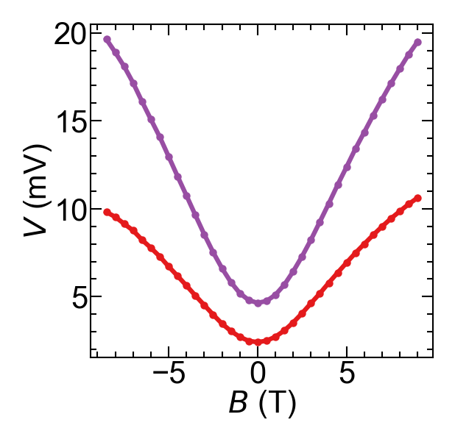
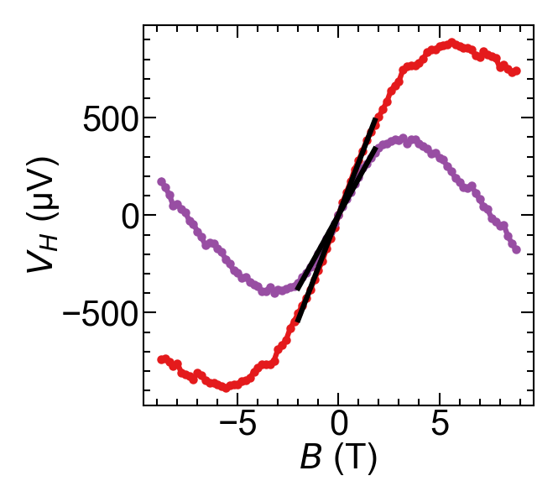
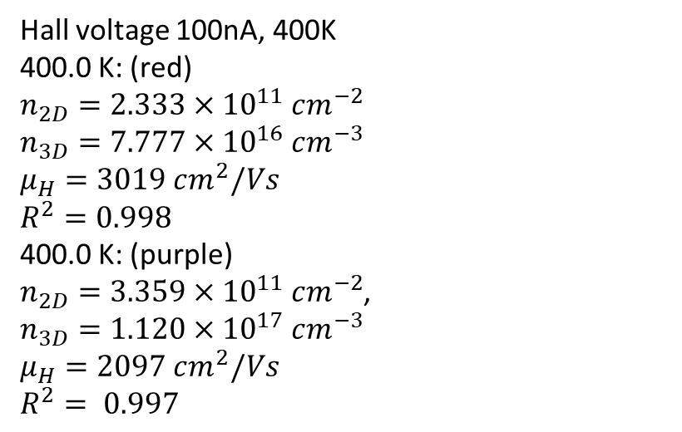
4pt magneto-resistance, two pairs of contacts
100nA, 400K
Hall voltage 100nA, 400K
400.0 K: (red)
$n_{2D}=2.333×{10}^{11} cm^{−2}$
$n_{3D}=7.777×{10}^{16} cm^{−3}$
$μ_{H}=3019 cm^{2}/Vs$
$R^{2}=0.998$
400.0 K: (purple)
$n_{2D}=3.359×{10}^{11} cm^{−2}$,
$n_{3D}=1.120×{10}^{17} cm^{−3}$
$μ_{H}=2097 cm^{2}/Vs$
$R^{2}= 0.997$

Slide 10
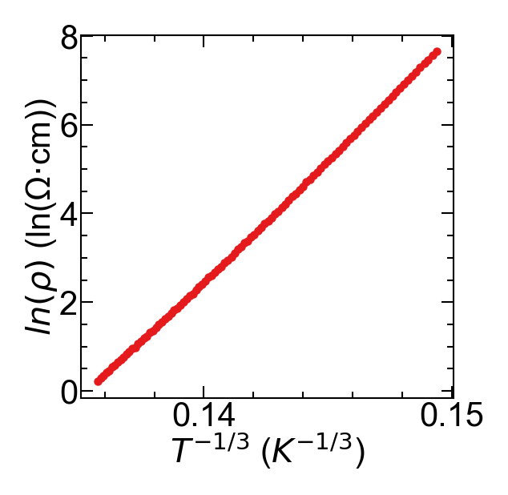
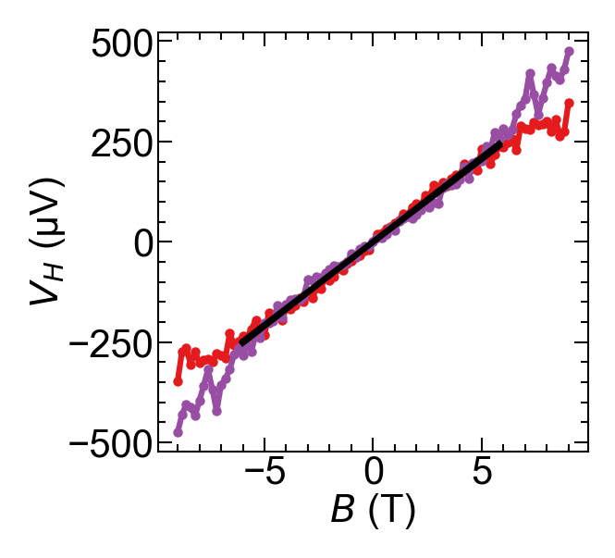
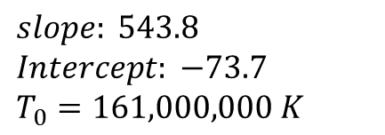
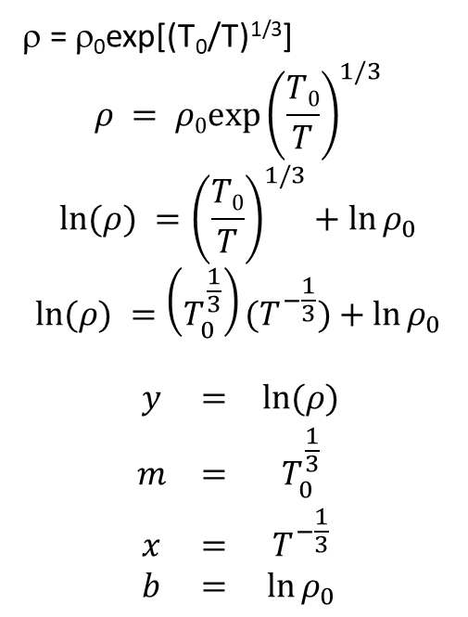
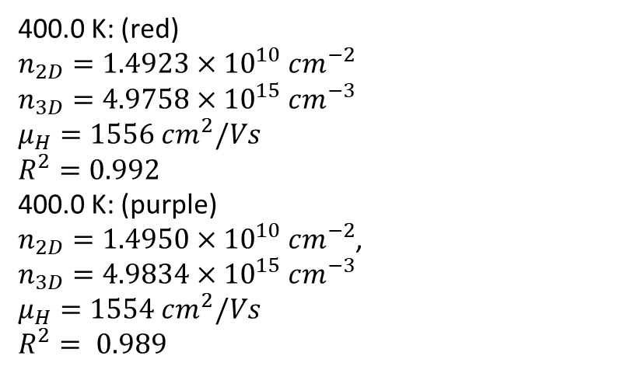
Sample: Large trapezoid A
$slope: 543.8$
$Intercept: −73.7$
$T_{0}=161,000,000 K$
ρ = ρ₀exp[(T₀/T)^{1/3}]
$$ρ = ρ0exp⁡{\left(\frac{T0}{T}\right)}^{1/3}$$
$$\ln{(ρ)} ={\left(\frac{T0}{T}\right)}^{1/3}+\ln{ρ_{0}}$$
$$\ln{(ρ)} =\left(T_{0}^{\frac{1}{3}}\right)(T^{−\frac{1}{3}})+\ln{ρ_{0}}$$
$$\begin{matrix}y & = & \ln{(ρ)} \\ m & = & T_{0}^{\frac{1}{3}} \\ x & = & T^{−\frac{1}{3}} \\ b & = & \ln{ρ_{0}}\end{matrix}$$
400.0 K: (red)
$n_{2D}=1.4923×{10}^{10} cm^{−2}$
$n_{3D}=4.9758×{10}^{15} cm^{−3}$
$μ_{H}=1556 cm^{2}/Vs$
$R^{2}=0.992$
400.0 K: (purple)
$n_{2D}=1.4950×{10}^{10} cm^{−2}$,
$n_{3D}=4.9834×{10}^{15} cm^{−3}$
$μ_{H}=1554 cm^{2}/Vs$
$R^{2}= 0.989$

Slide 11
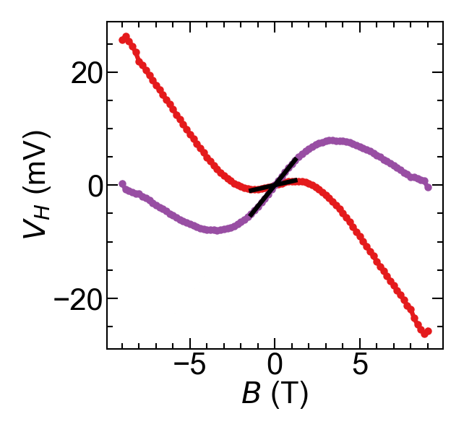
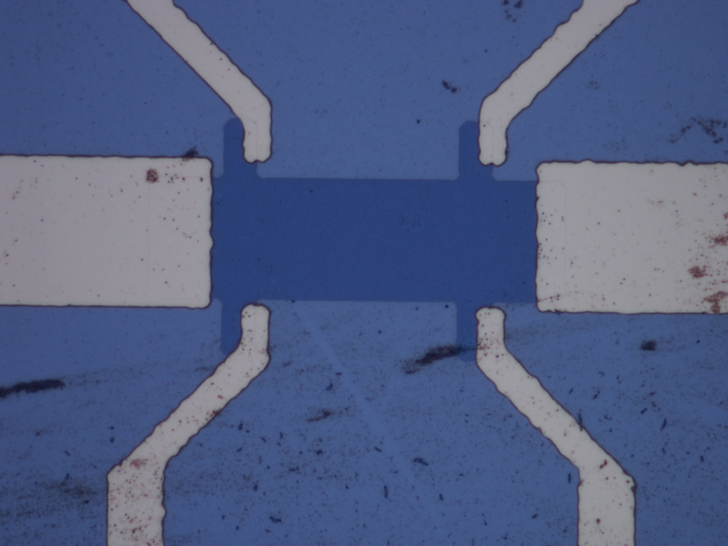
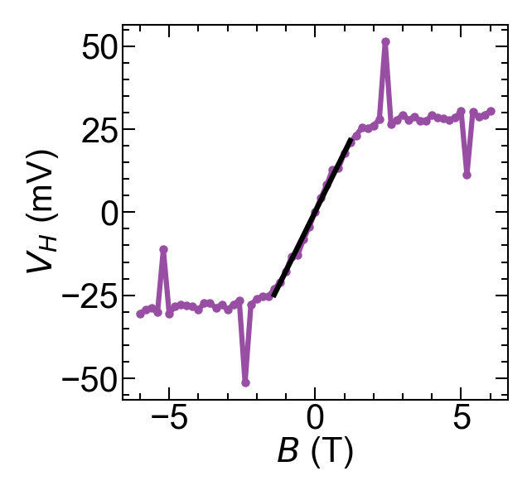
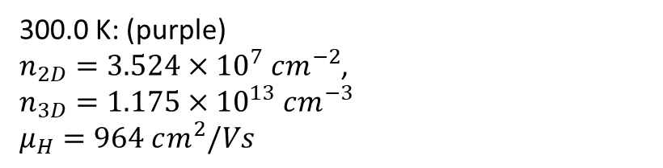
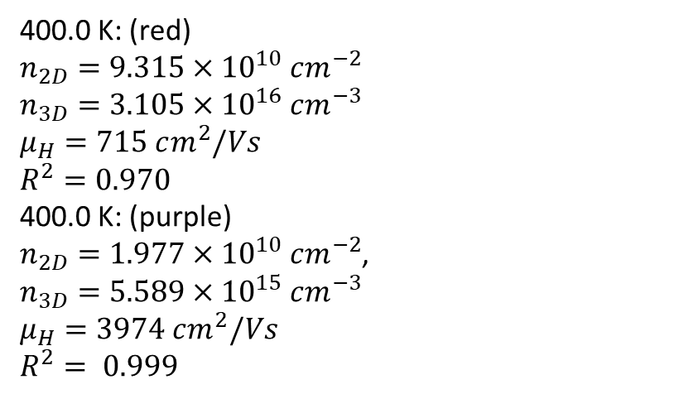
Sample: Large trapezoid B
400.0 K: (red)
$n_{2D}=9.315×{10}^{10} cm^{−2}$
$n_{3D}=3.105×{10}^{16} cm^{−3}$
$μ_{H}=715 cm^{2}/Vs$
$R^{2}=0.970$
400.0 K: (purple)
$n_{2D}=1.977×{10}^{10} cm^{−2}$,
$n_{3D}=5.589×{10}^{15} cm^{−3}$
$μ_{H}=3974 cm^{2}/Vs$
$R^{2}= 0.999$
400K, 100nA
300K, 1nA
300.0 K: (purple)
$n_{2D}=3.524×{10}^{7} cm^{−2}$,
$n_{3D}=1.175×{10}^{13} cm^{−3}$
$μ_{H}=964 cm^{2}/Vs$

